Slide 1
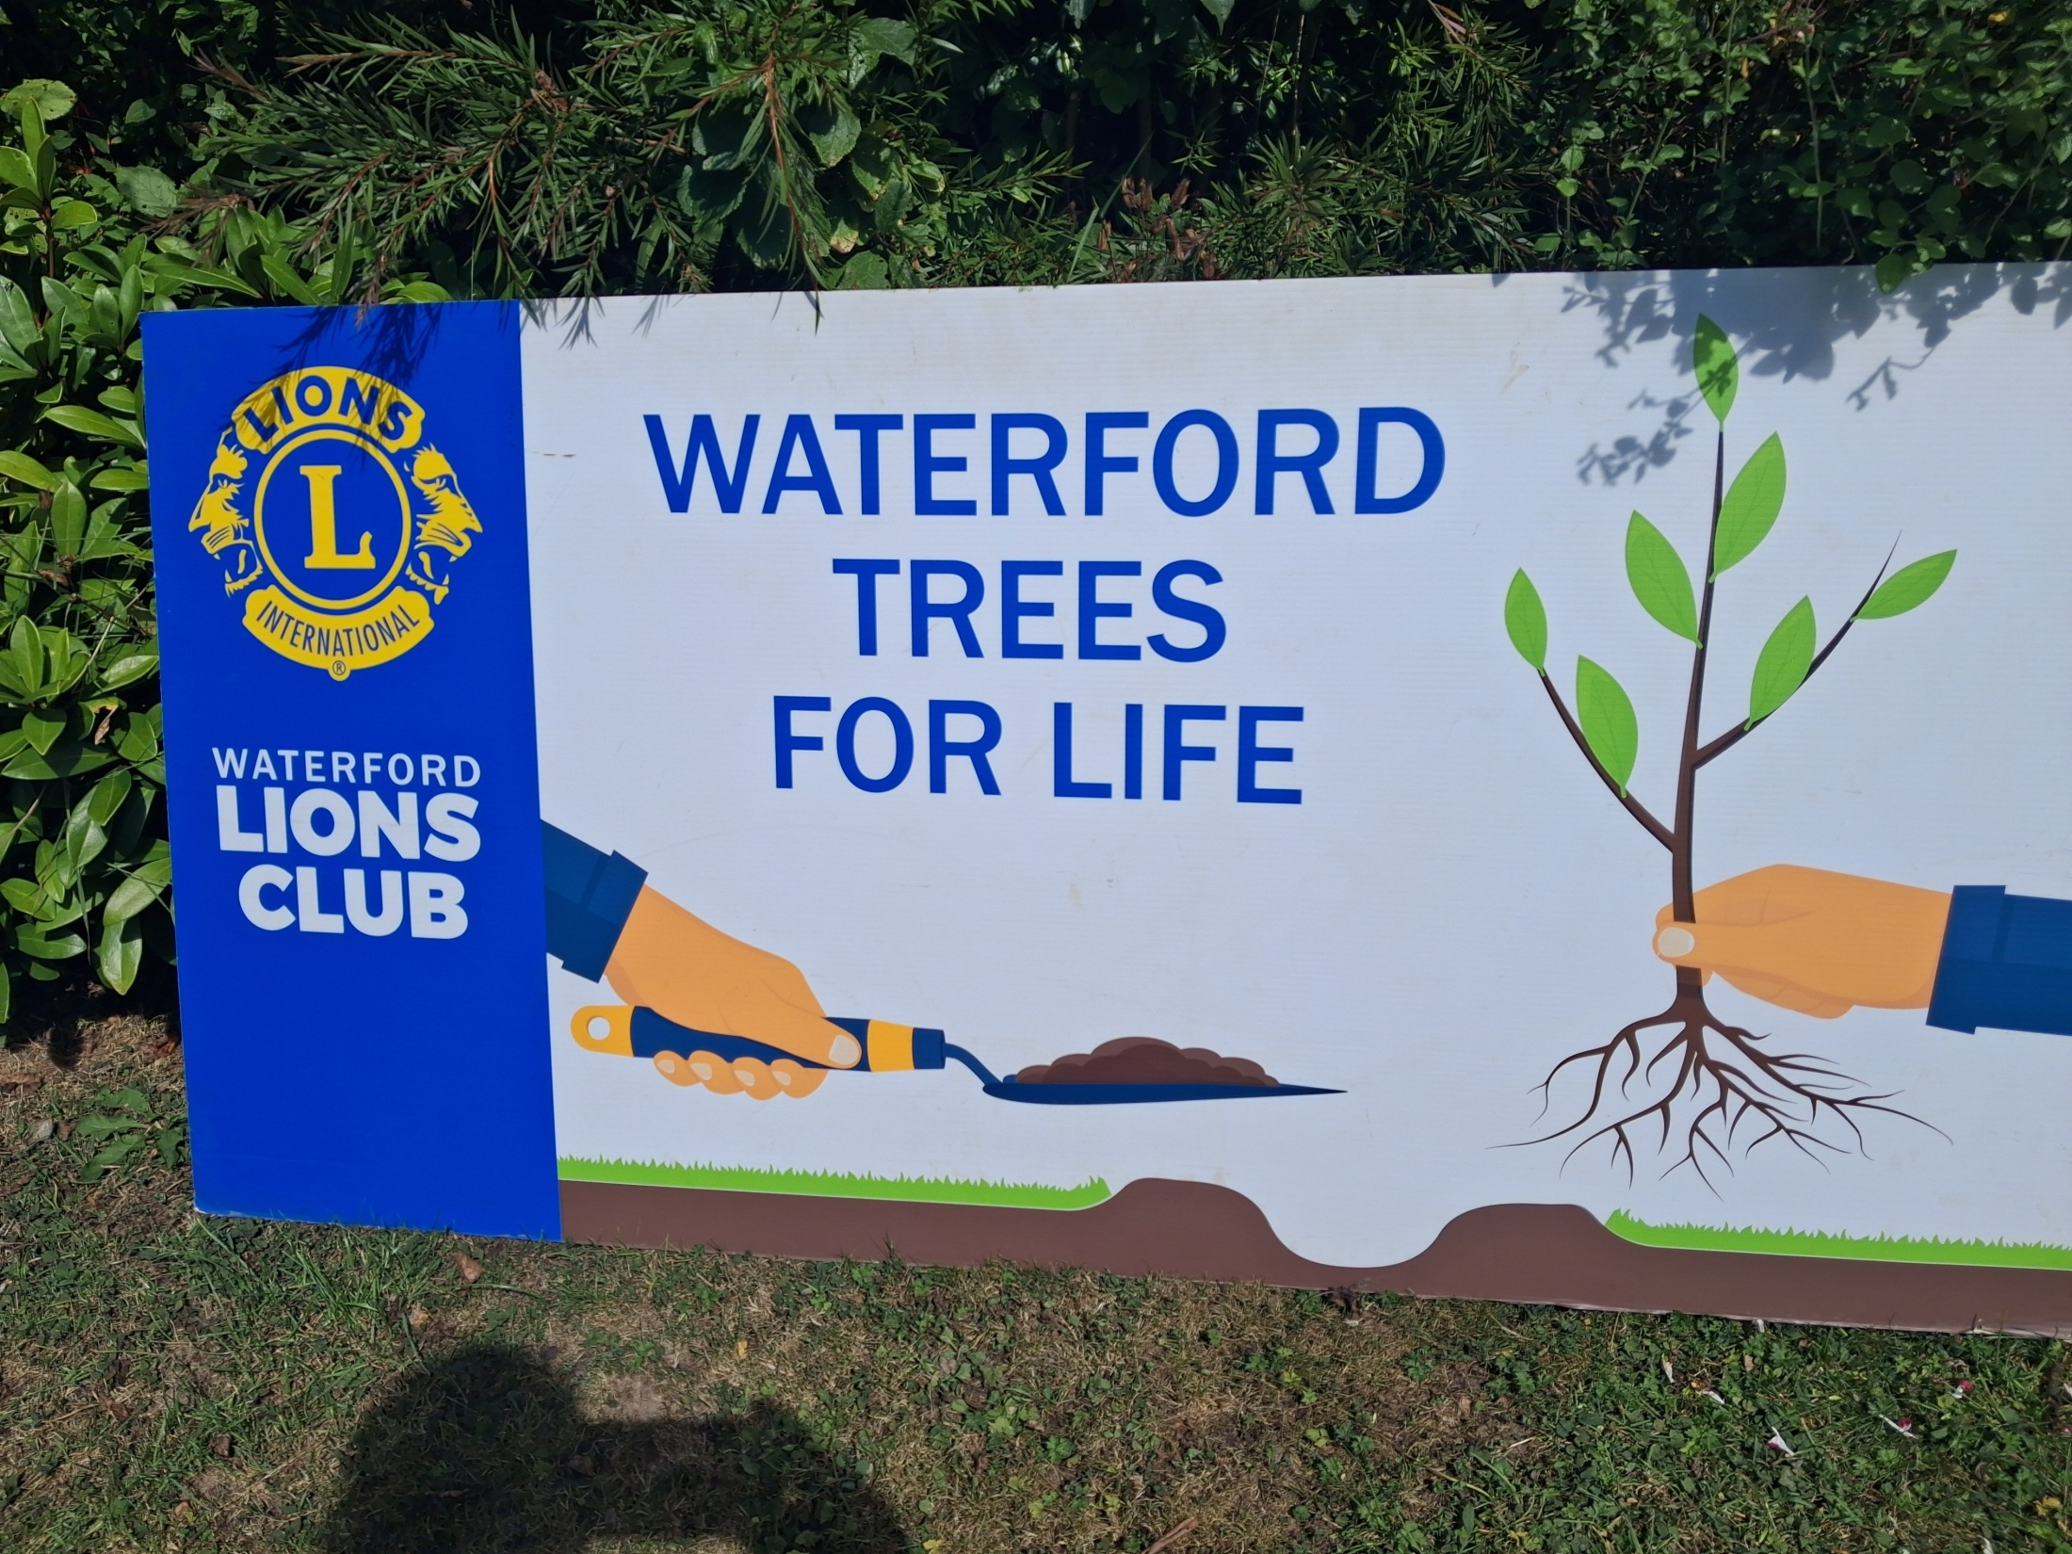

Slide 2

Waterford Lions Club
Member of Lions International
49,000 Clubs Worldwide
In 200 Countries
1.4 million members
93 Clubs in Ireland ( District 133 )
Waterford Lions Club founded in 1965
40 Members

Slide 3
Lions Global Causes
Hunger
Humanitarian
Disaster Relief
Diabetes
Childhood Cancer
Vision
Environment

Slide 4
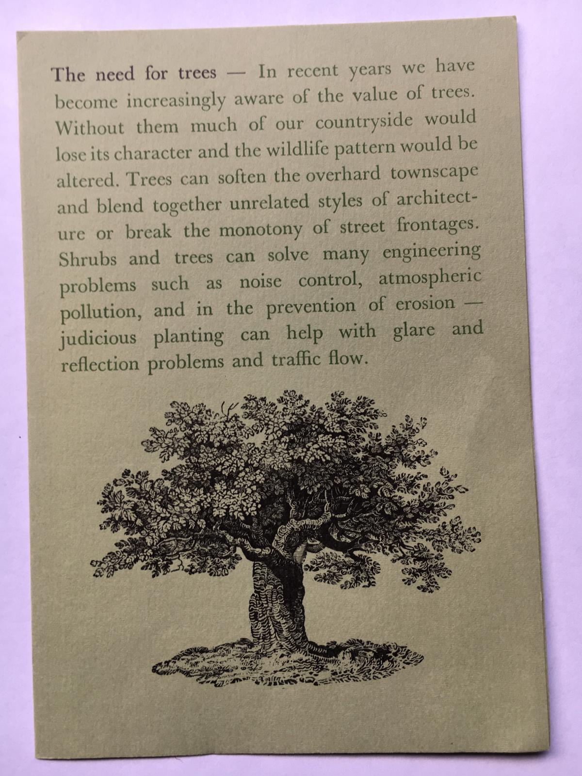
Thank You

Slide 5
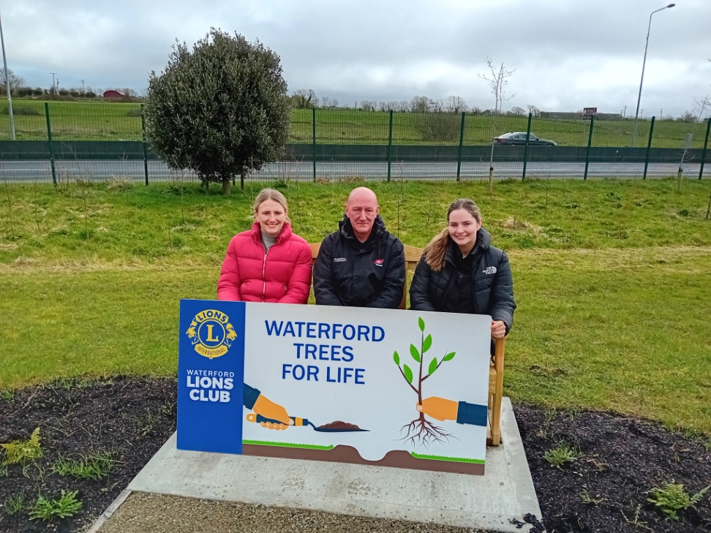
Waterford Trees For Life
We match corporate and business sponsors with schools and community groups and plant trees with the pupils and communities

Slide 6
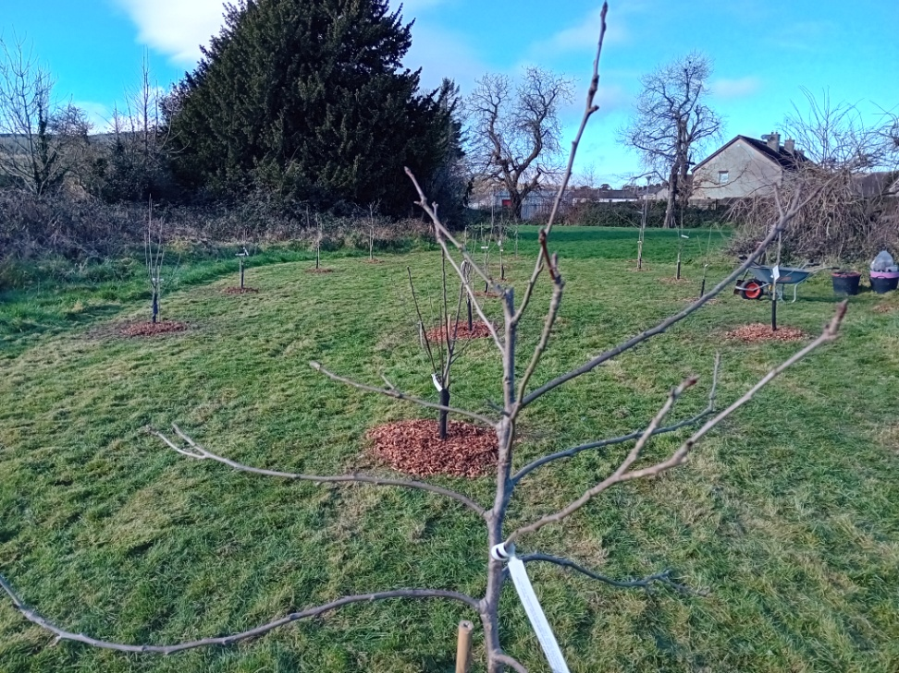
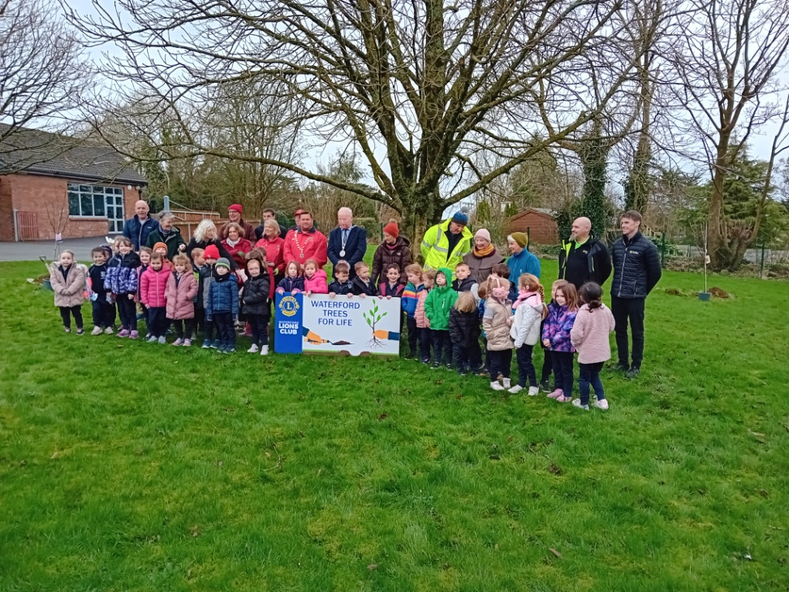
Our Motto
“Greening Waterford One Tree At A Time “

Slide 7
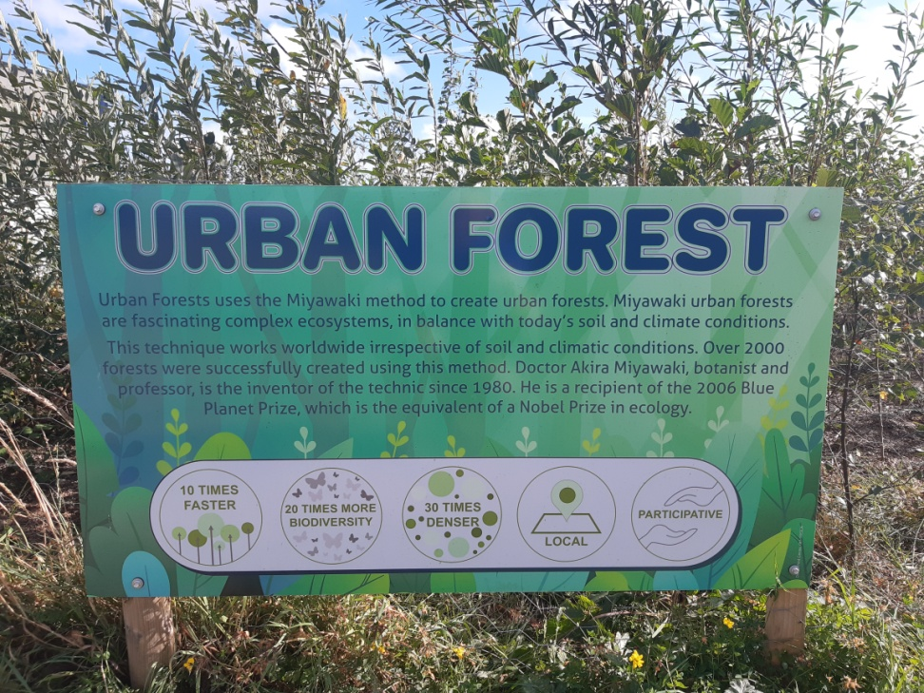
Project Types
Pocket Forests
Standards
Orchards

Slide 8
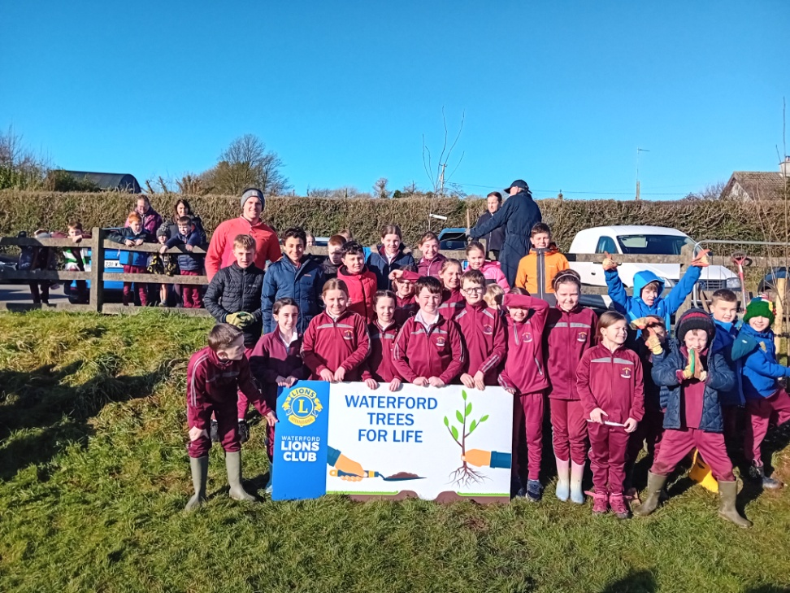
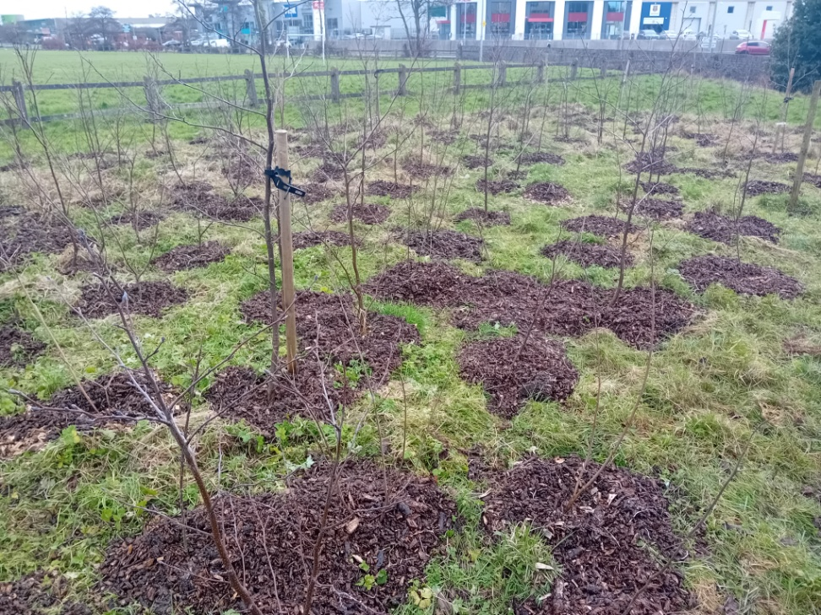
5th Season Planting

Slide 9
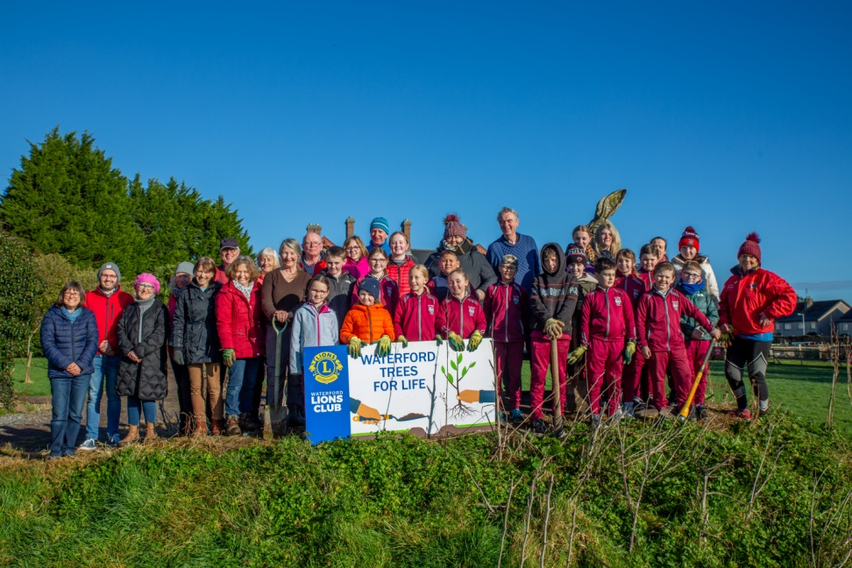
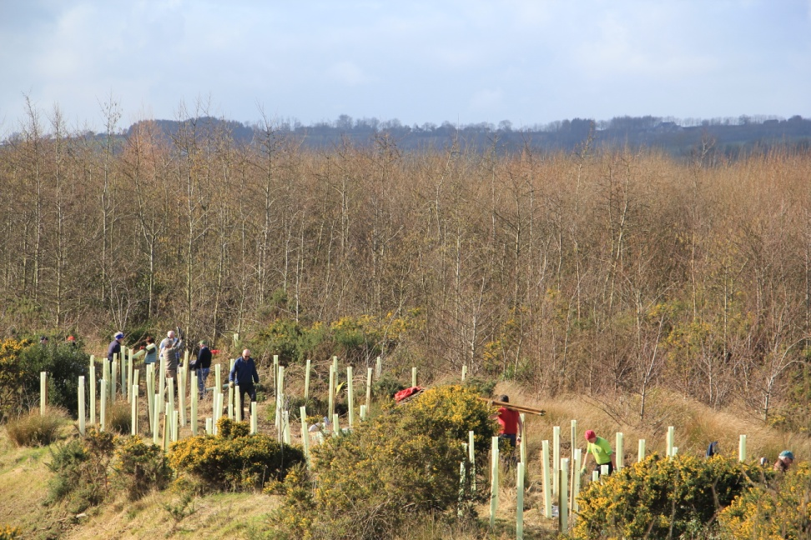
Over 60 Projects Completed In 5 Years

Slide 10
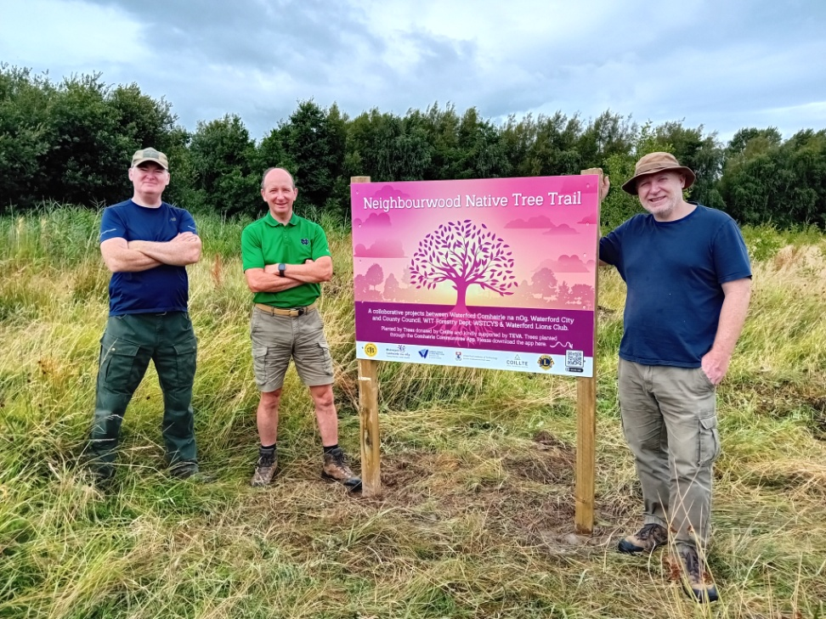
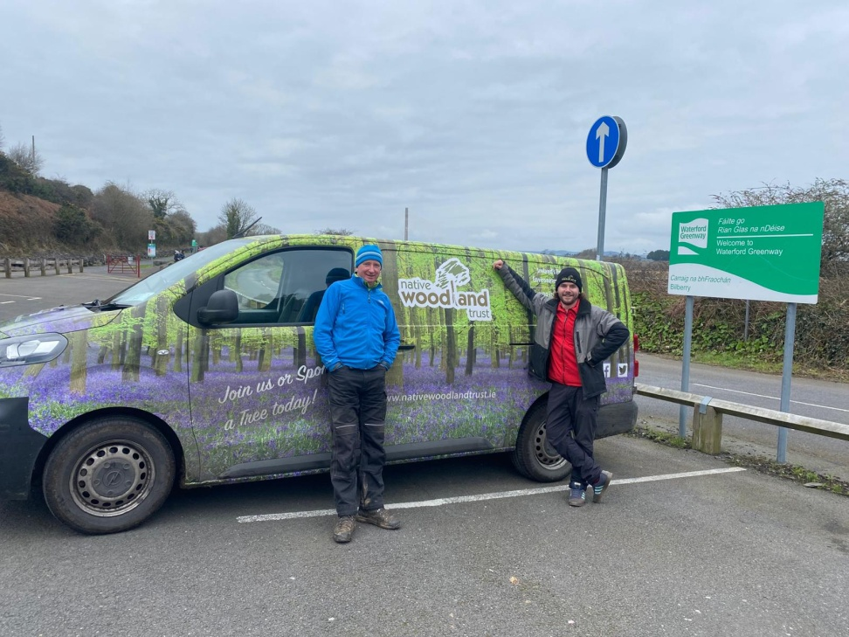
Partners
SETU Forestry Department
The Native Woodland Trust

Slide 11
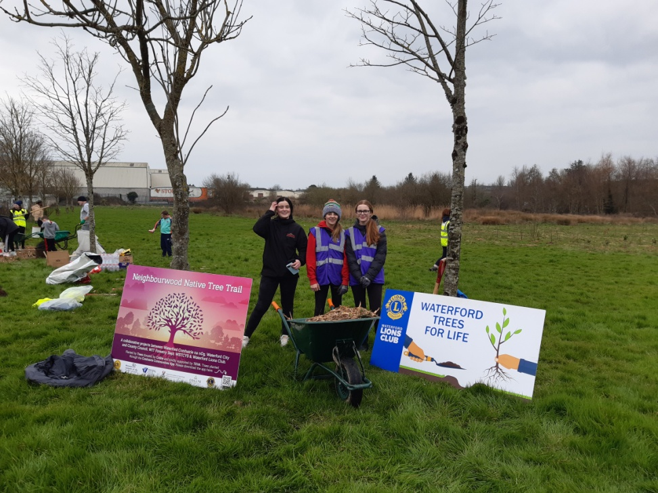
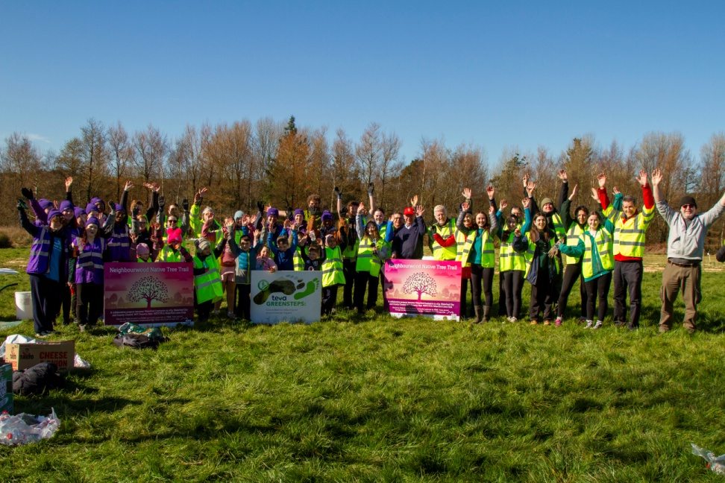
Partners
Waterford Youth Council
Waterford City And County Council

Slide 12
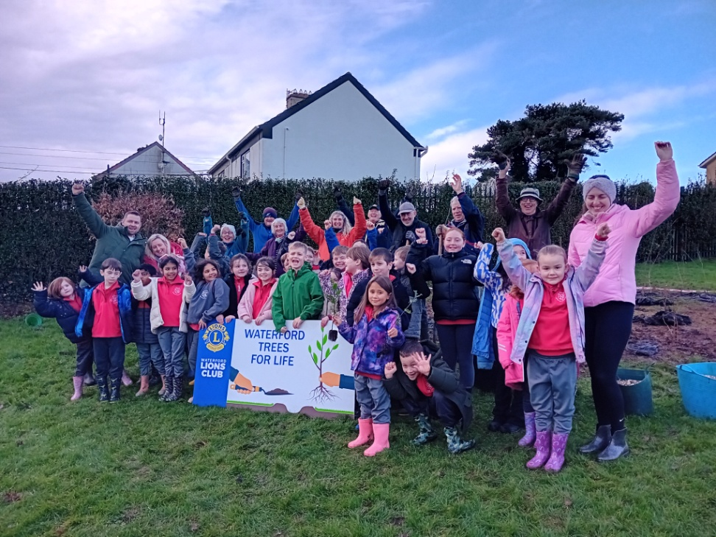
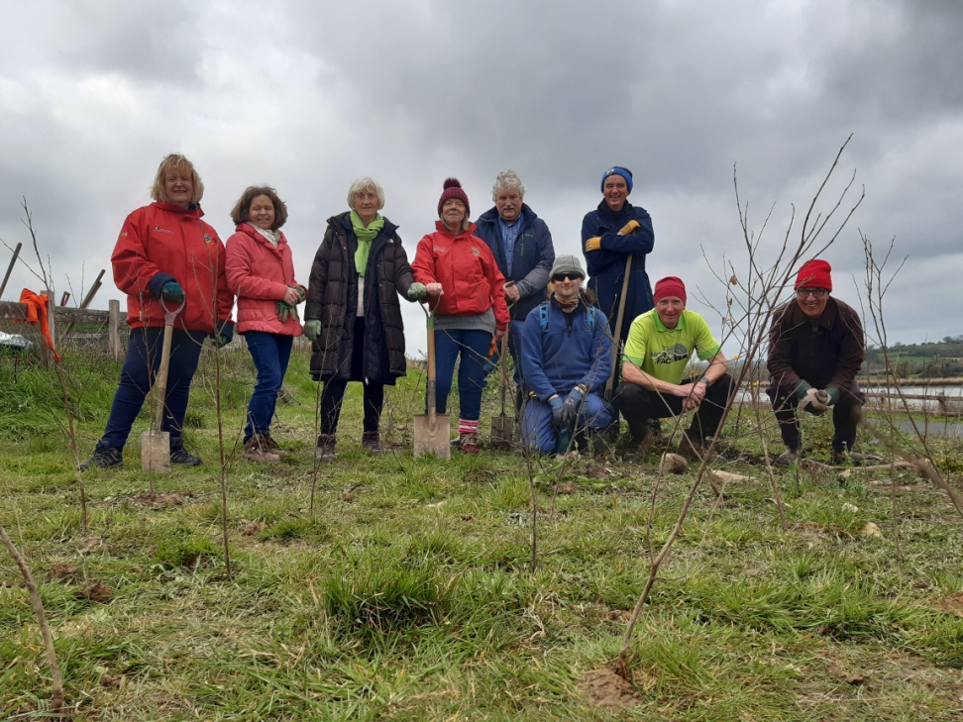
Partners
Schools- Too numerous to mention all.
The Brothers of Charity Tory Services and our volunteers

Slide 13
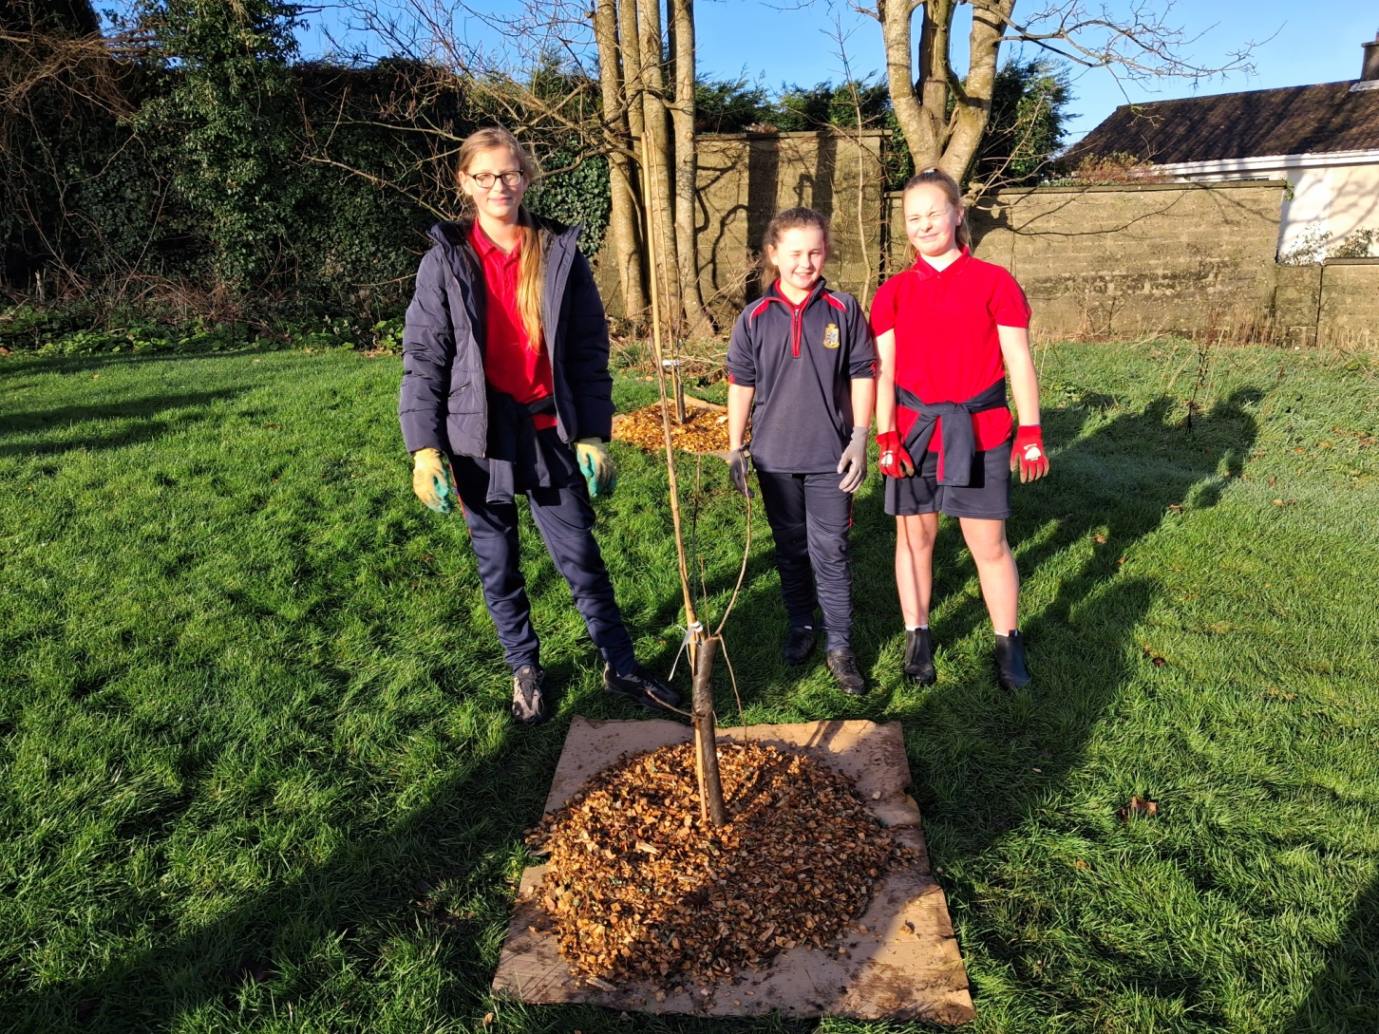
Winter / Spring 2026

Slide 14
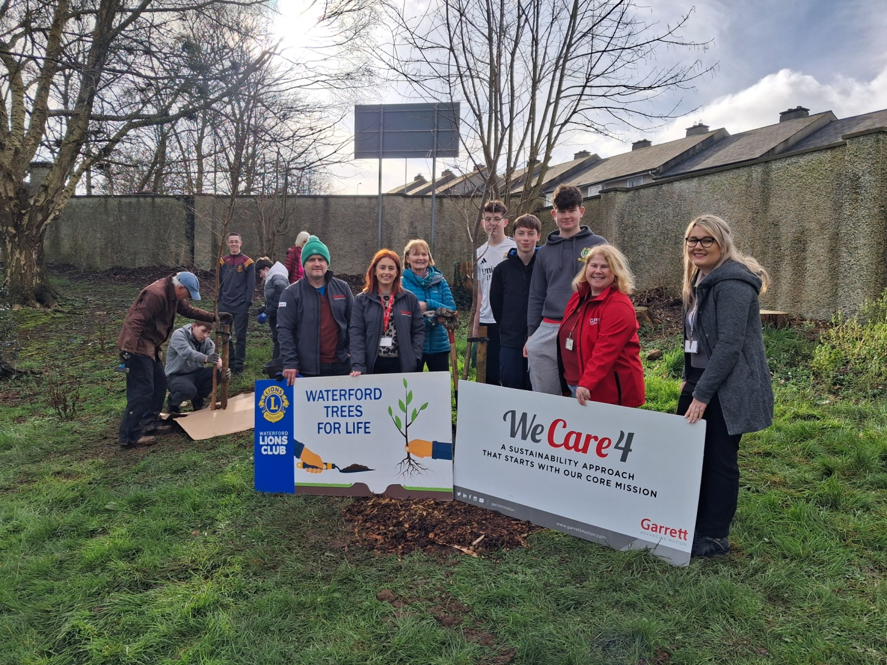
Spring 2026

Slide 15
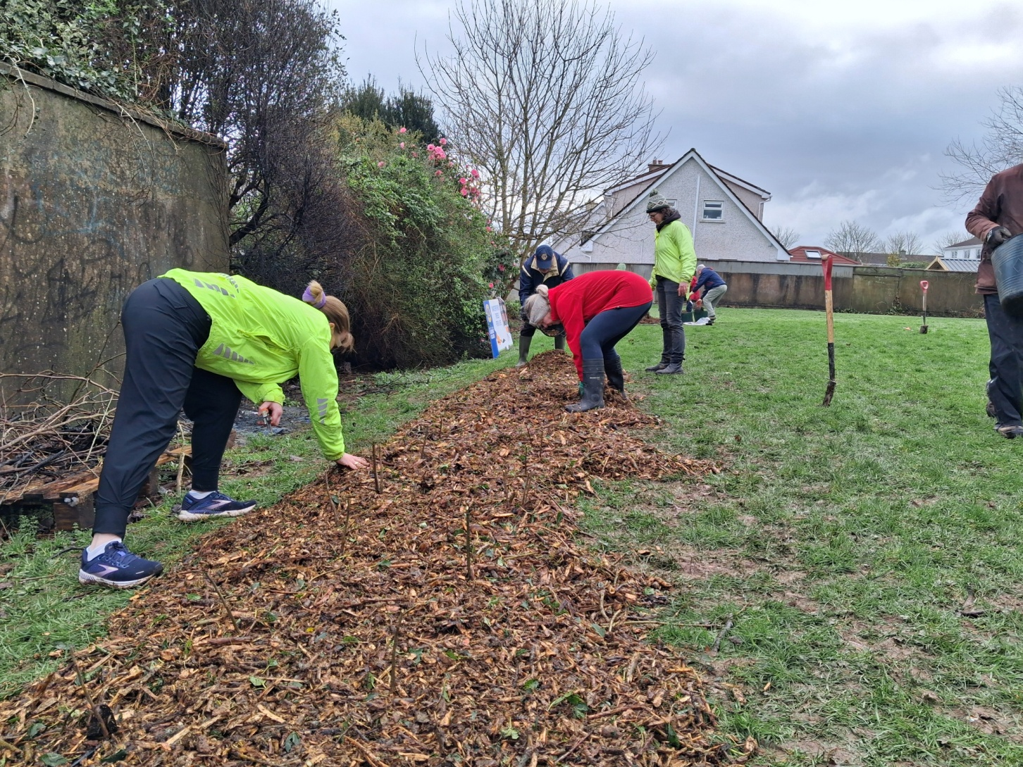
Spring 2026

Slide 16
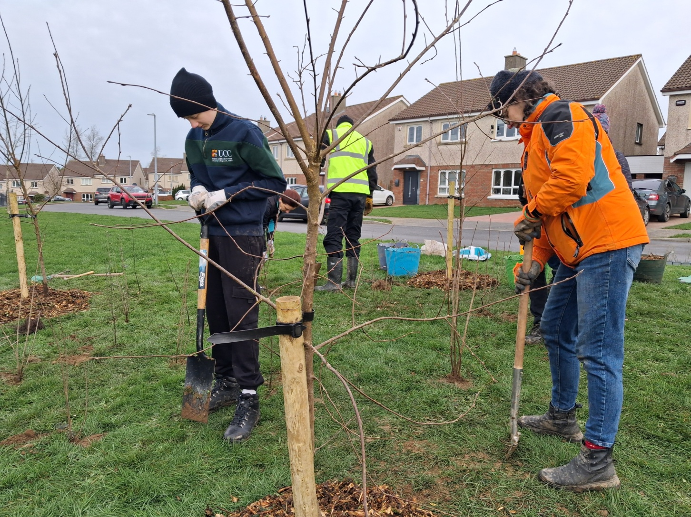
Spring 2026

Slide 17
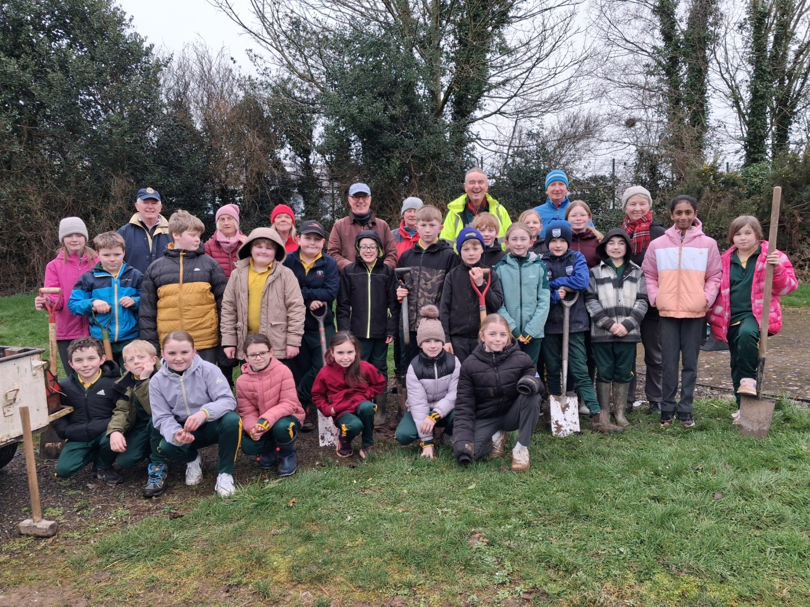
Spring 2026

Slide 18
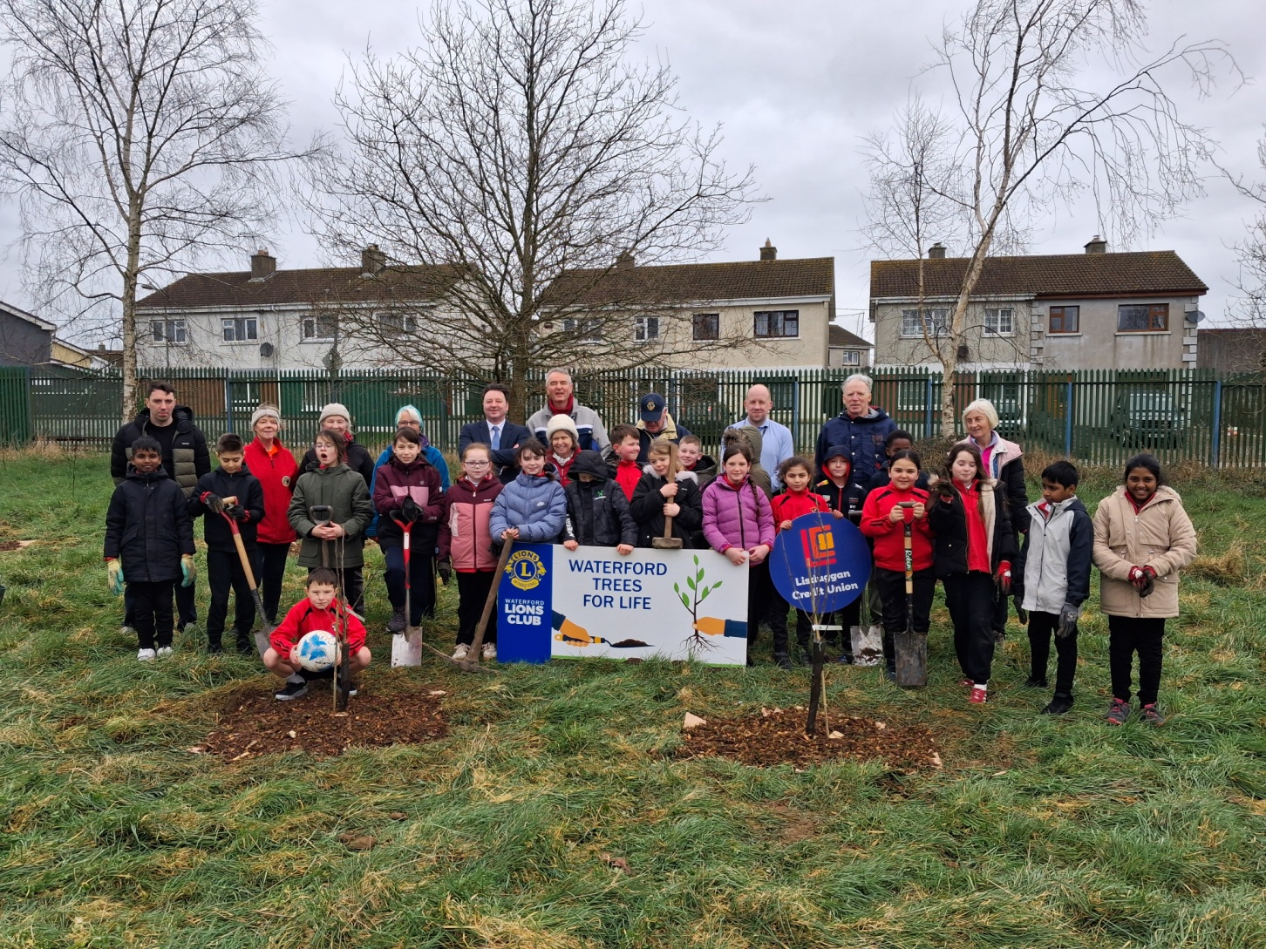
Spring 2026

Slide 19
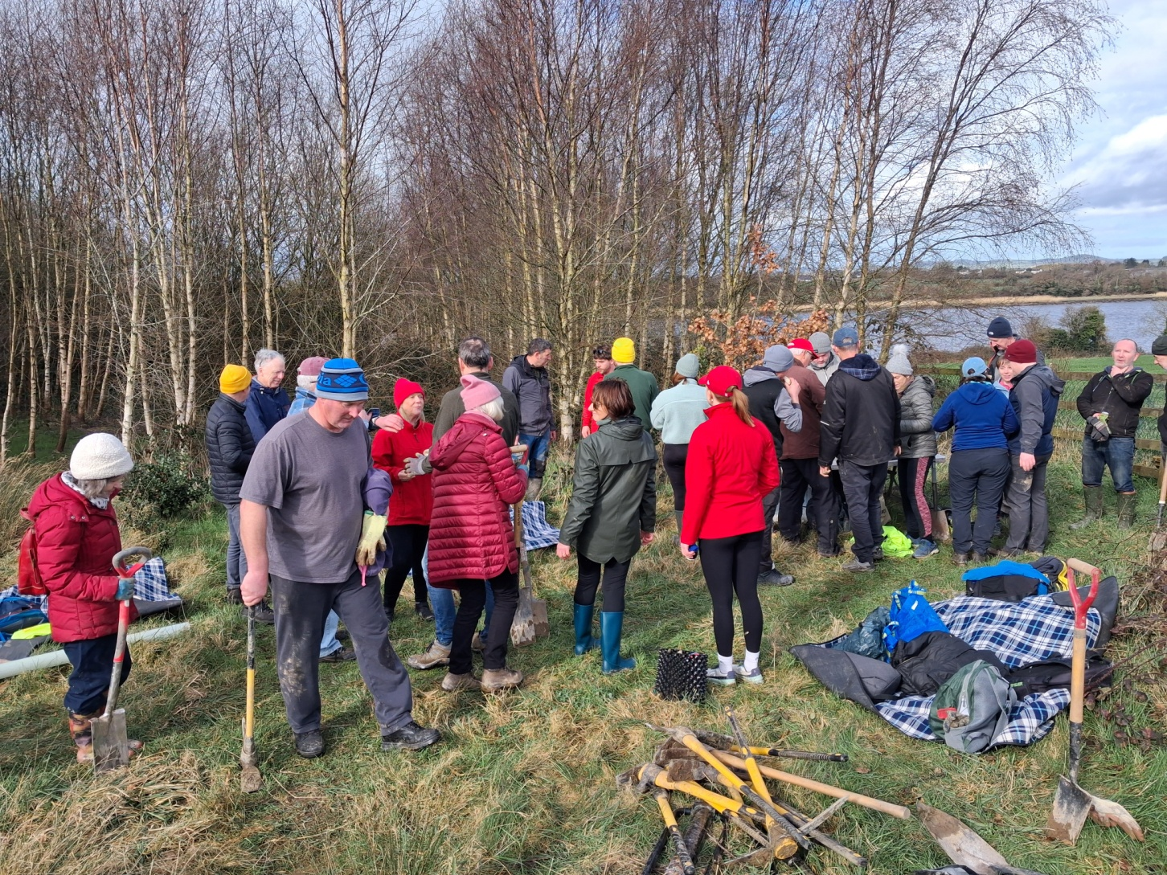
Spring 2026

Slide 20
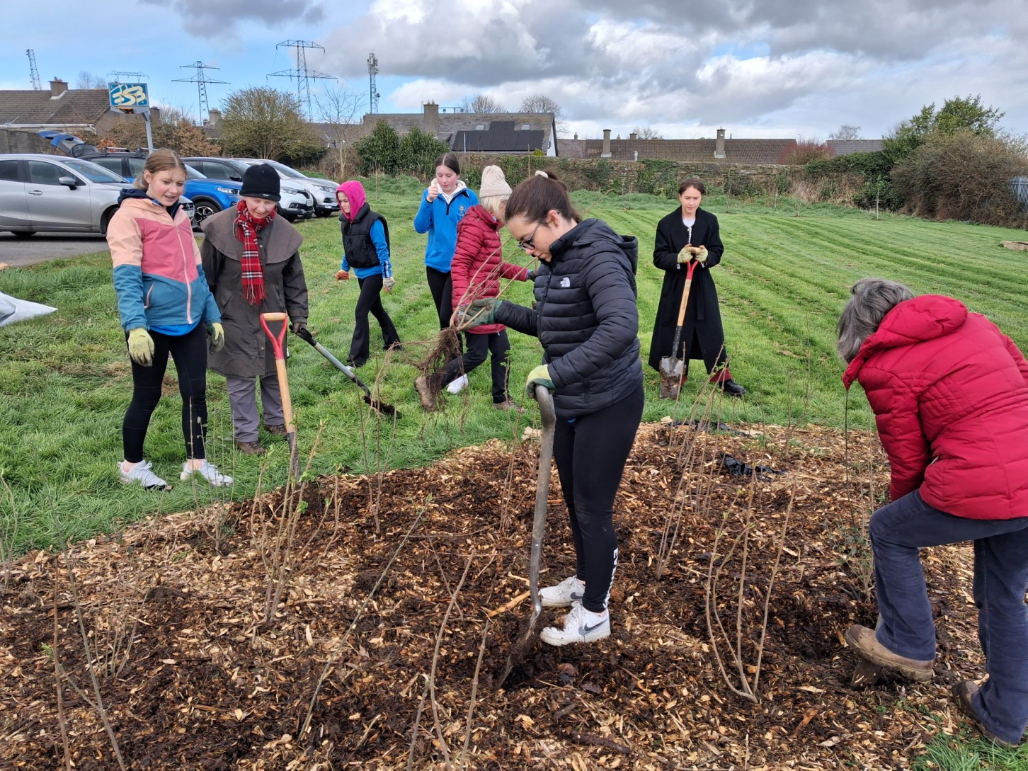
Spring 2026

Slide 21
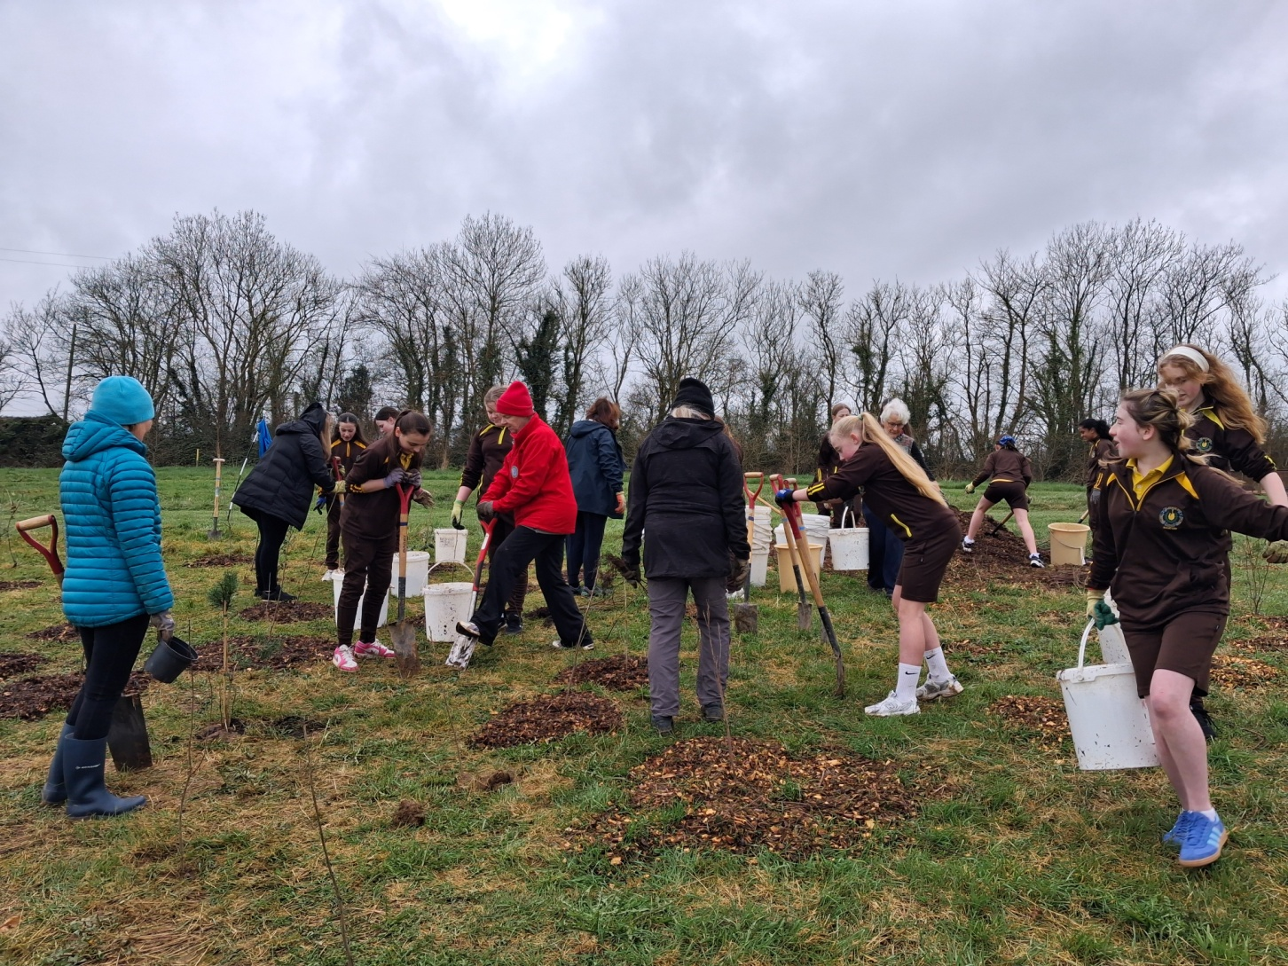
Spring 2026

Slide 22
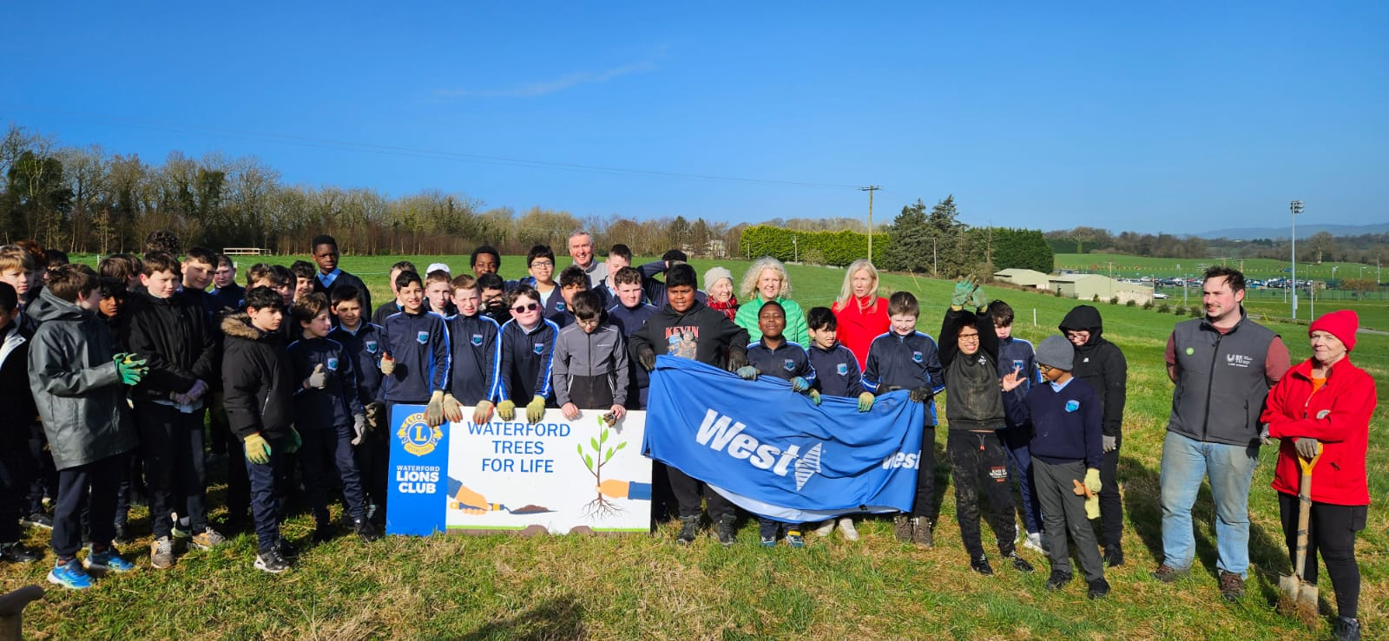
Spring 2026

Slide 23
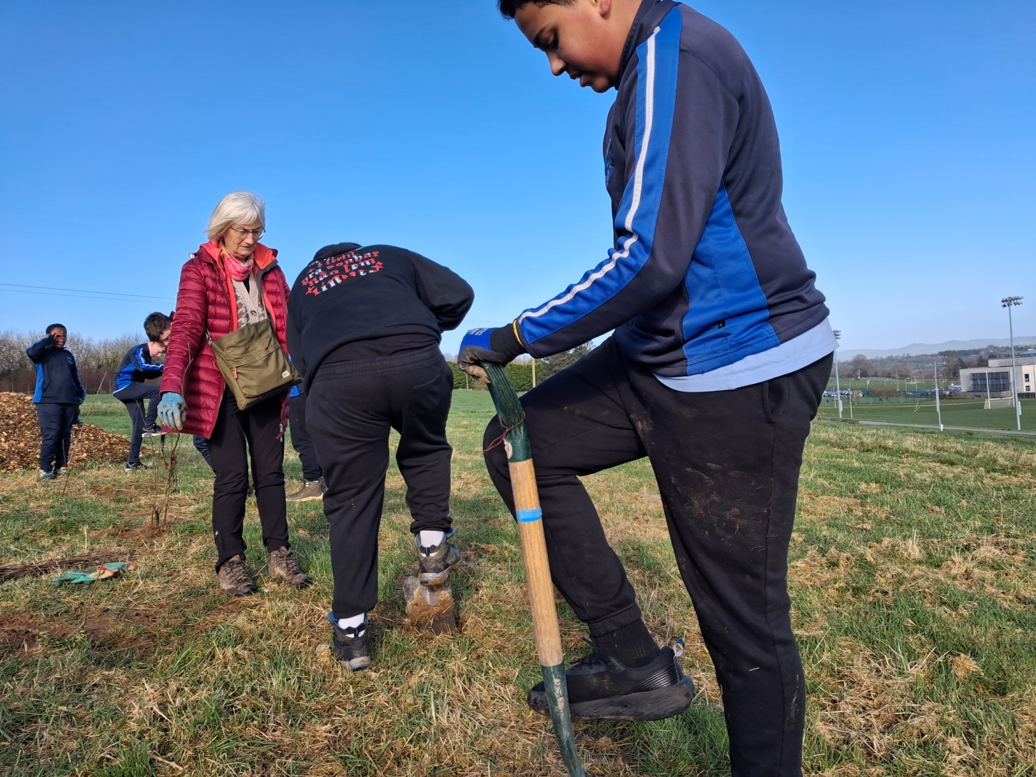
Spring 2026

Slide 24
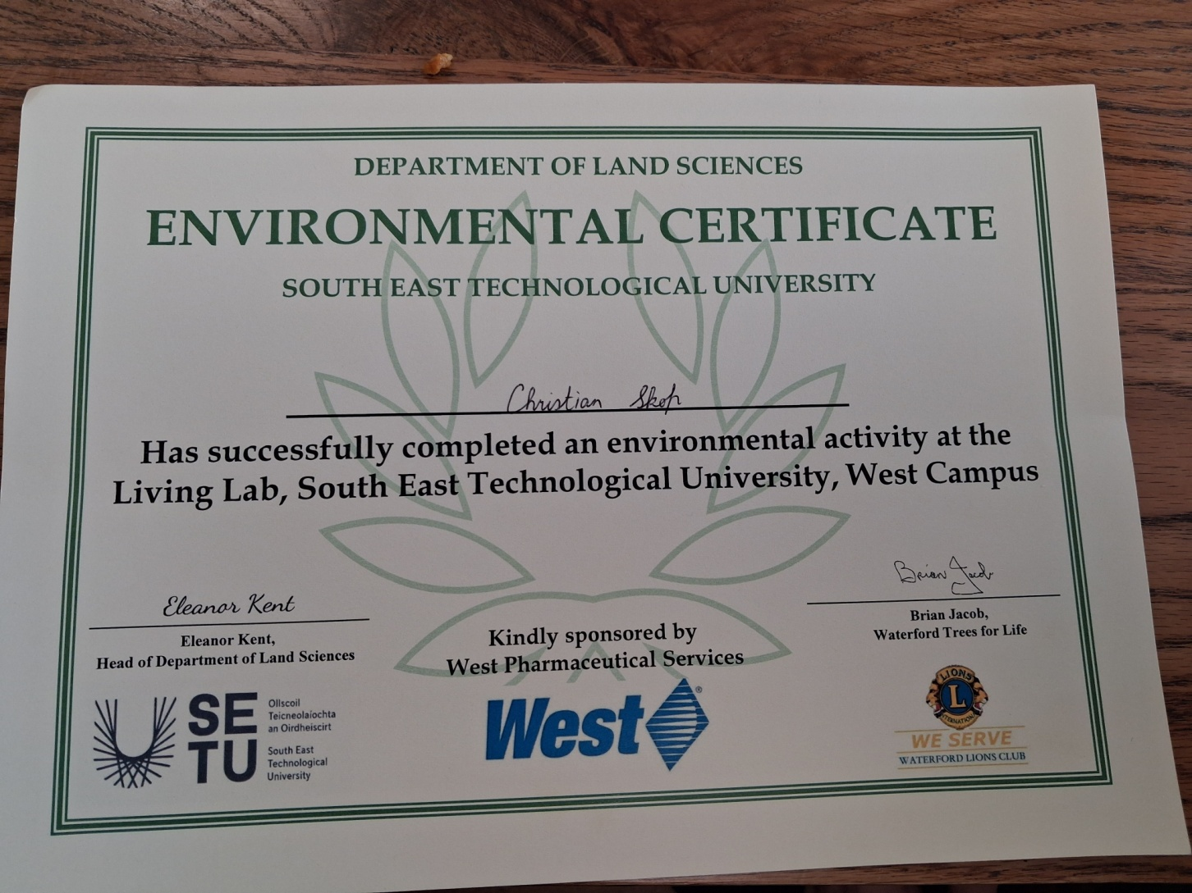
Spring 2026

Slide 25
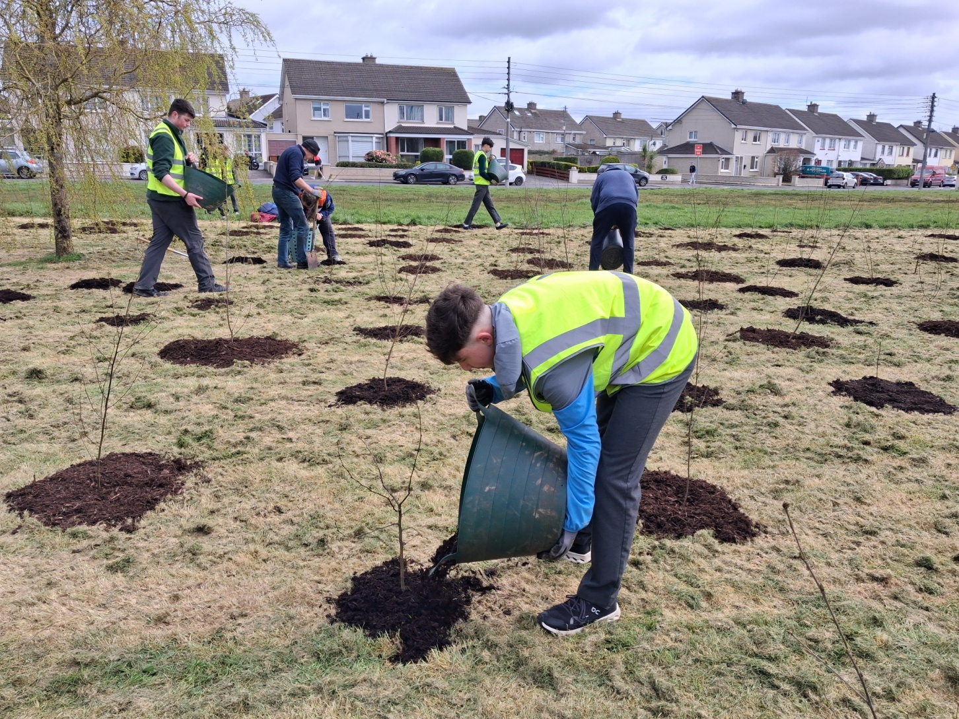
Spring 2026

Slide 26
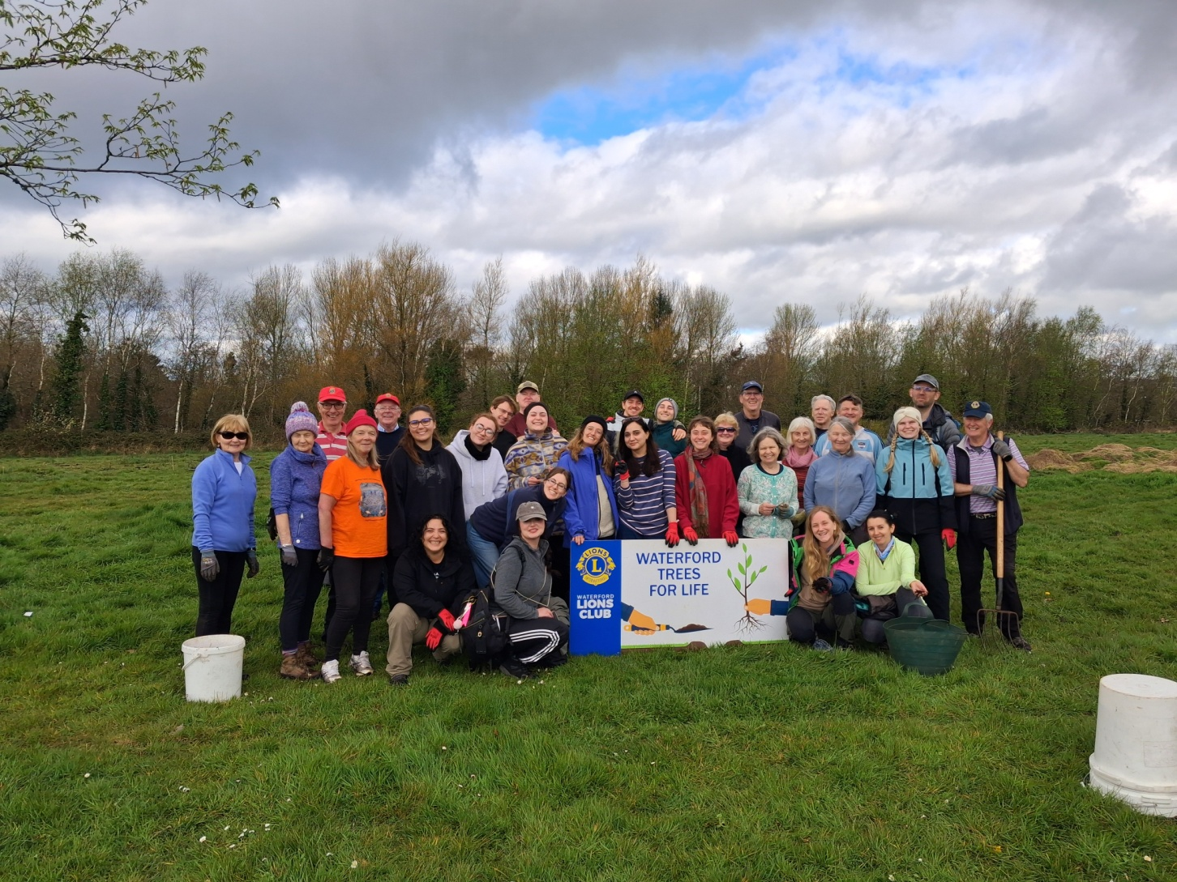
Spring 2026

Slide 27
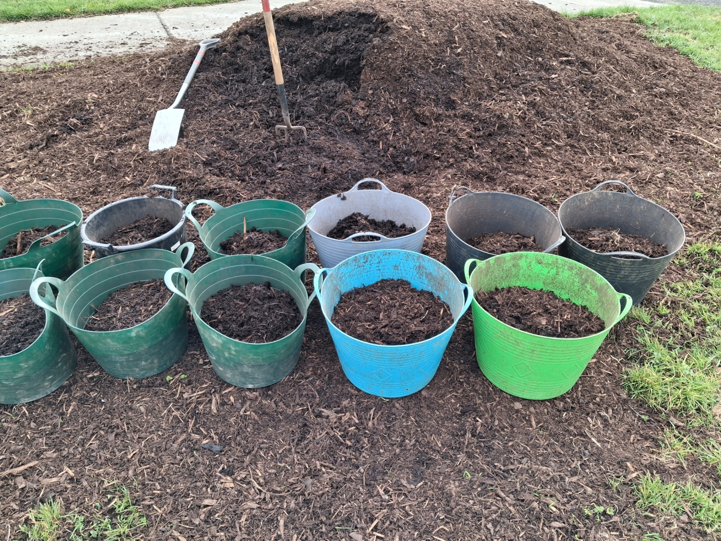
Spring 2026

Slide 28
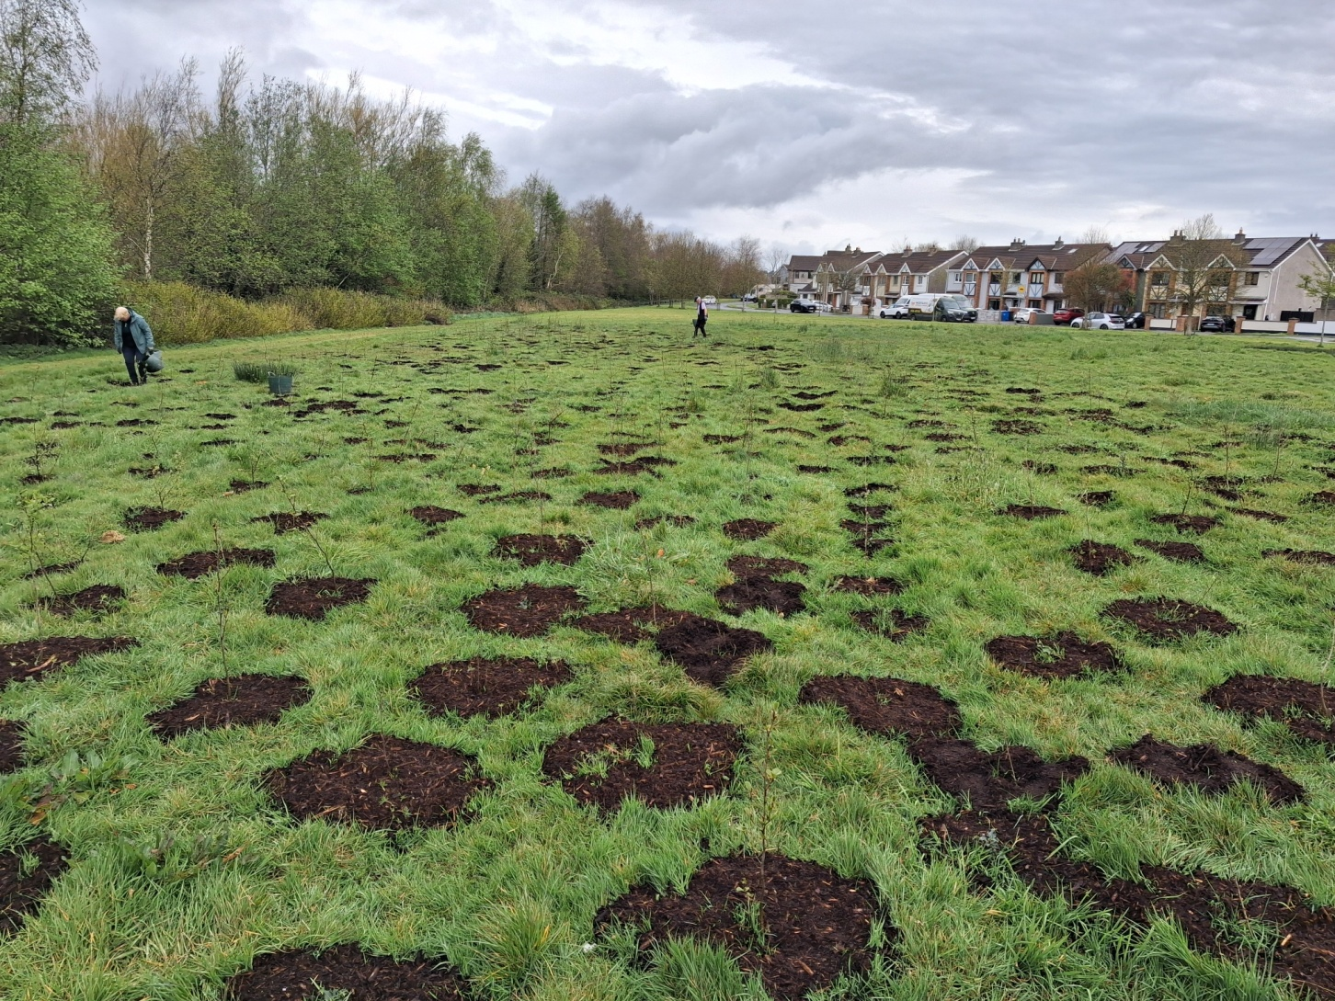
Spring 2026

Slide 29
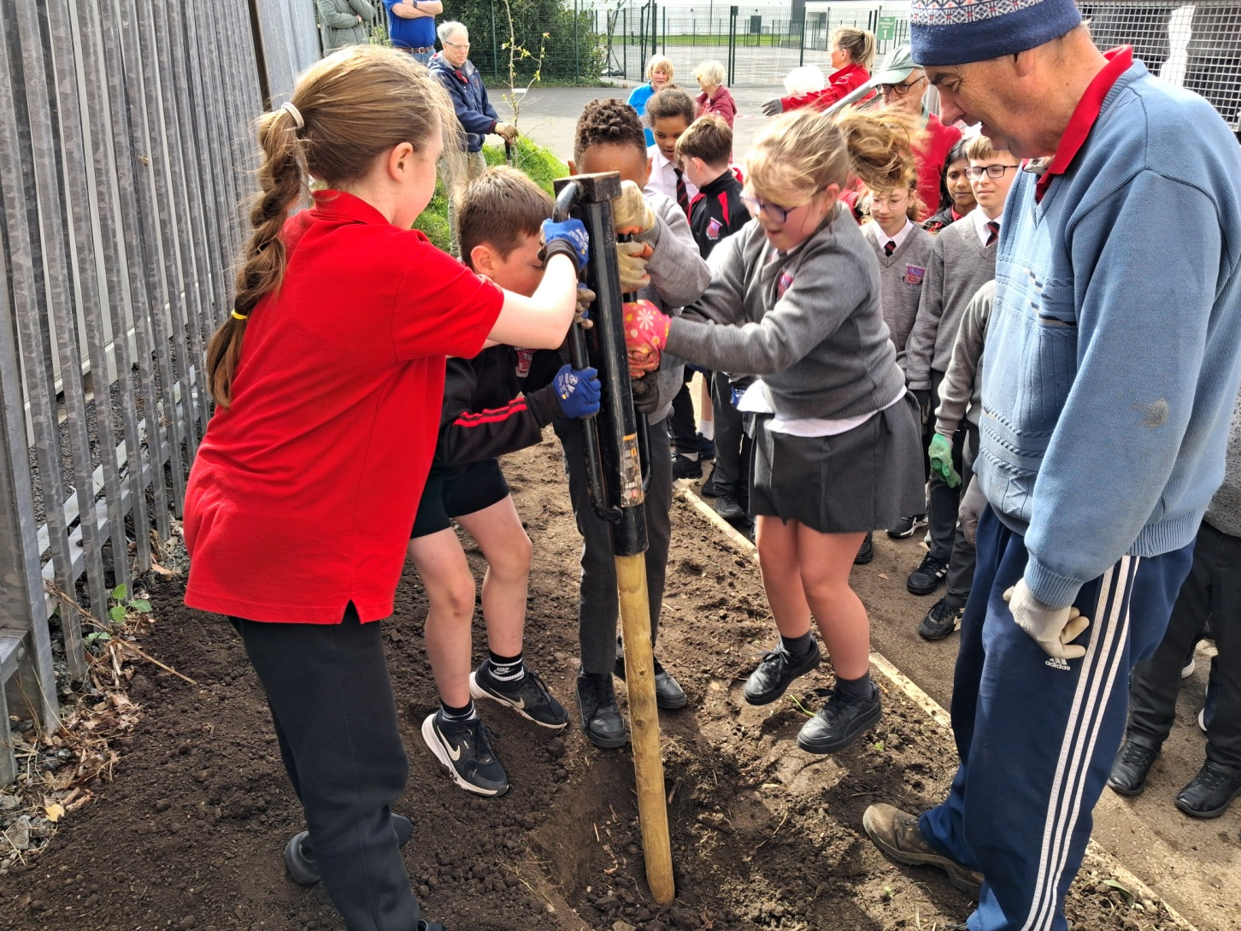
Spring 2026

Slide 30
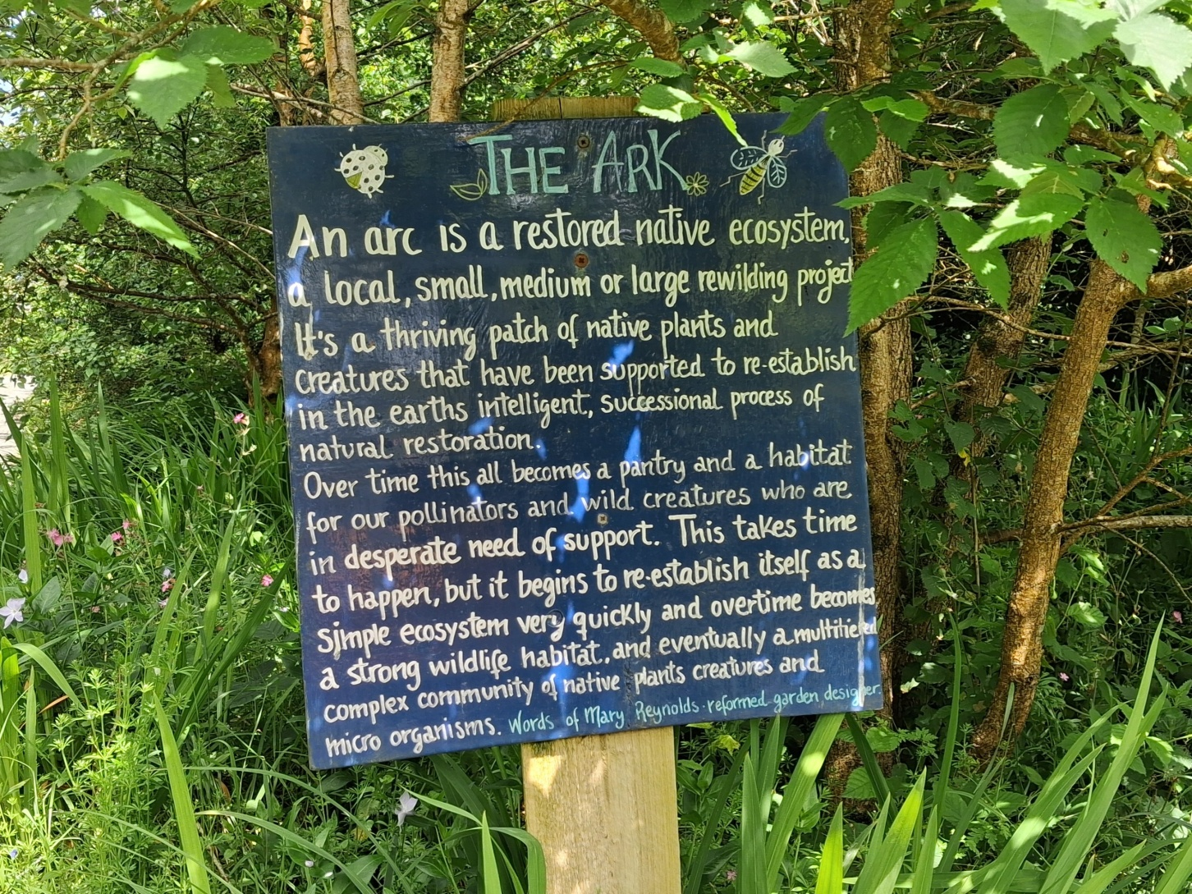
Spring 2026

Slide 31
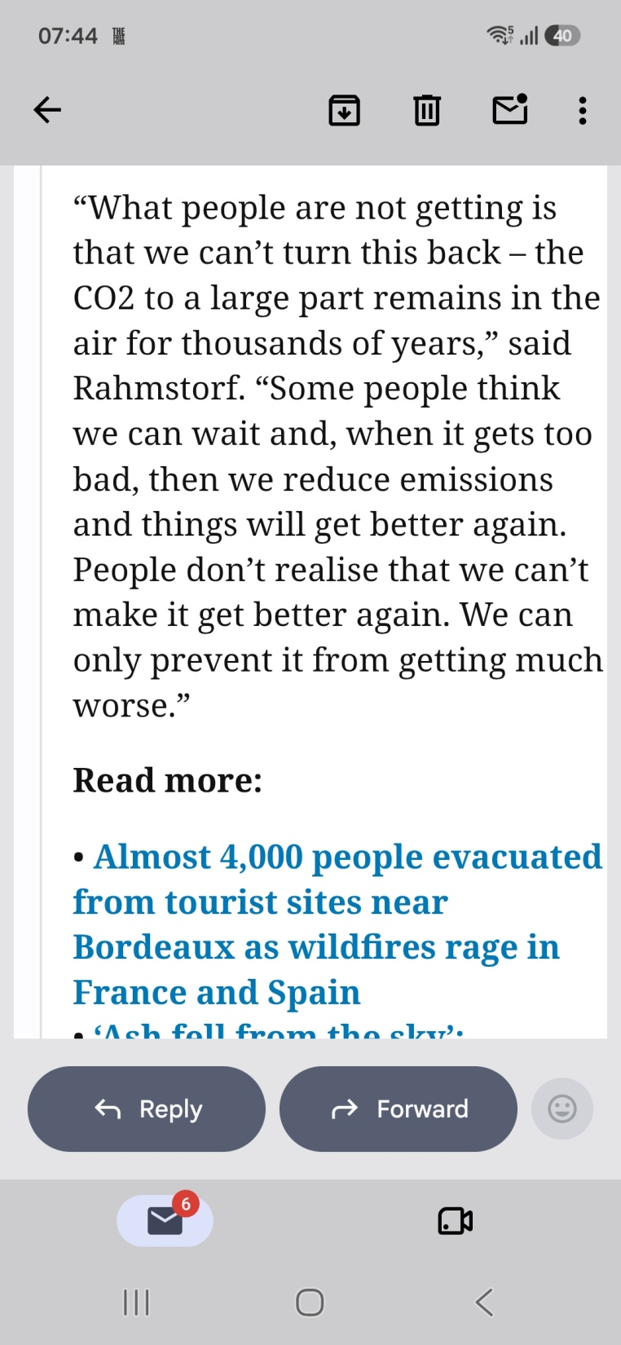

Slide 32
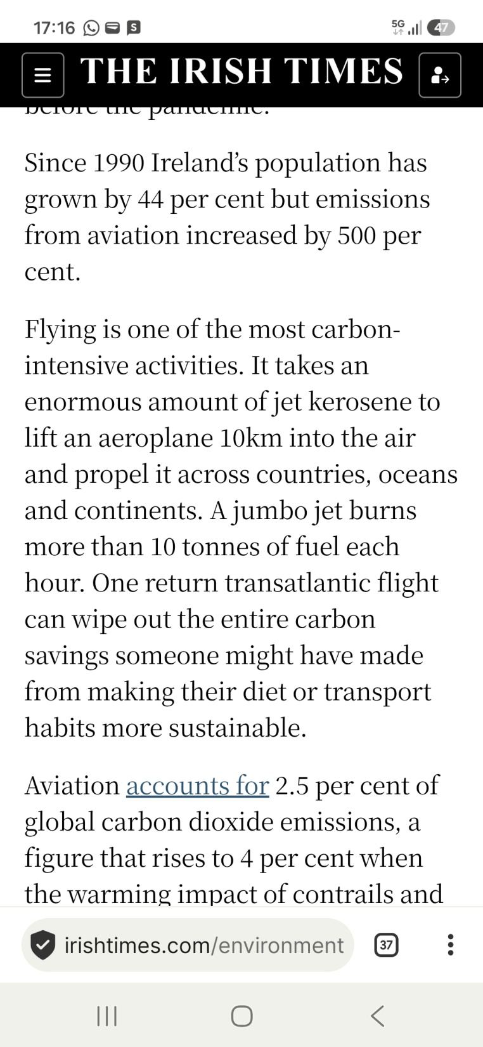

Slide 33
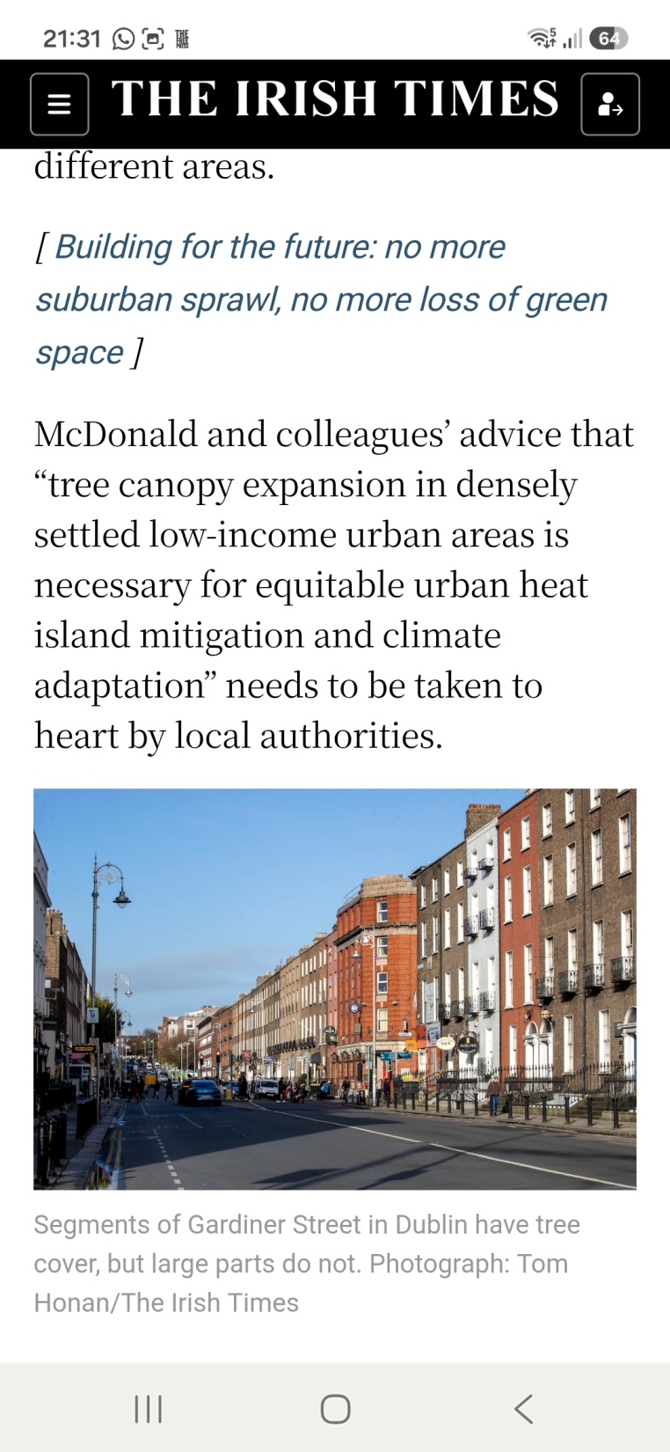

Slide 34
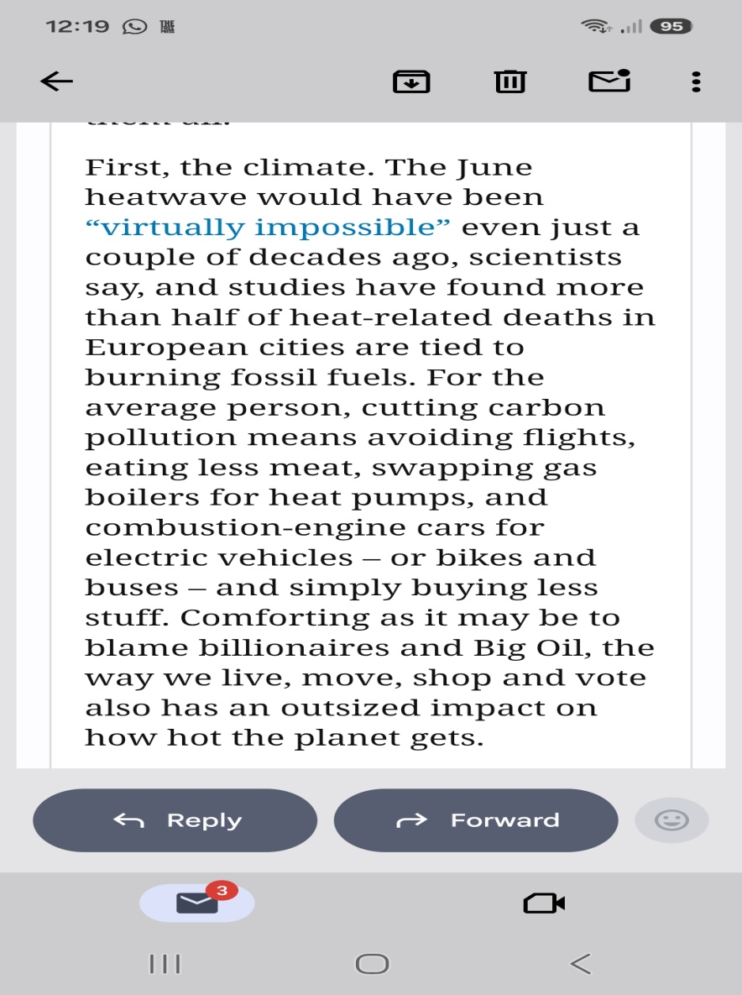
What can you do?

Slide 35
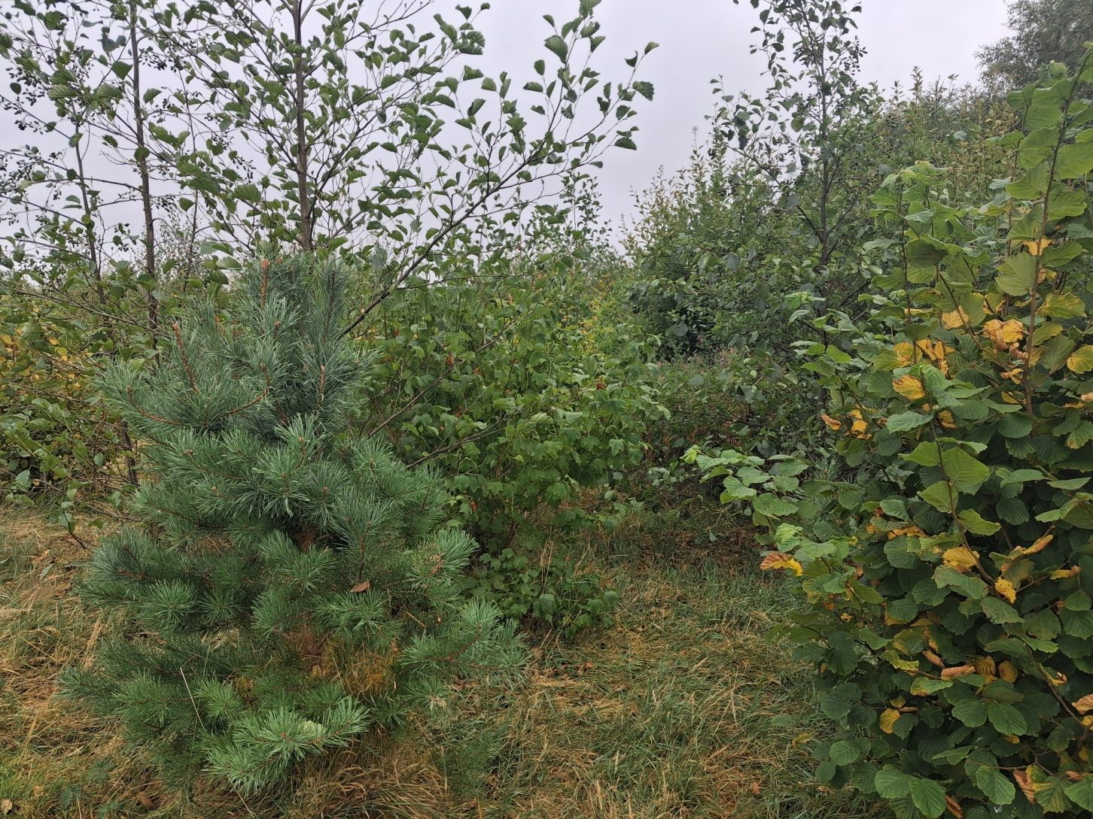
5 year old Pocket Forest

Slide 36

Thank You

