Slide 1
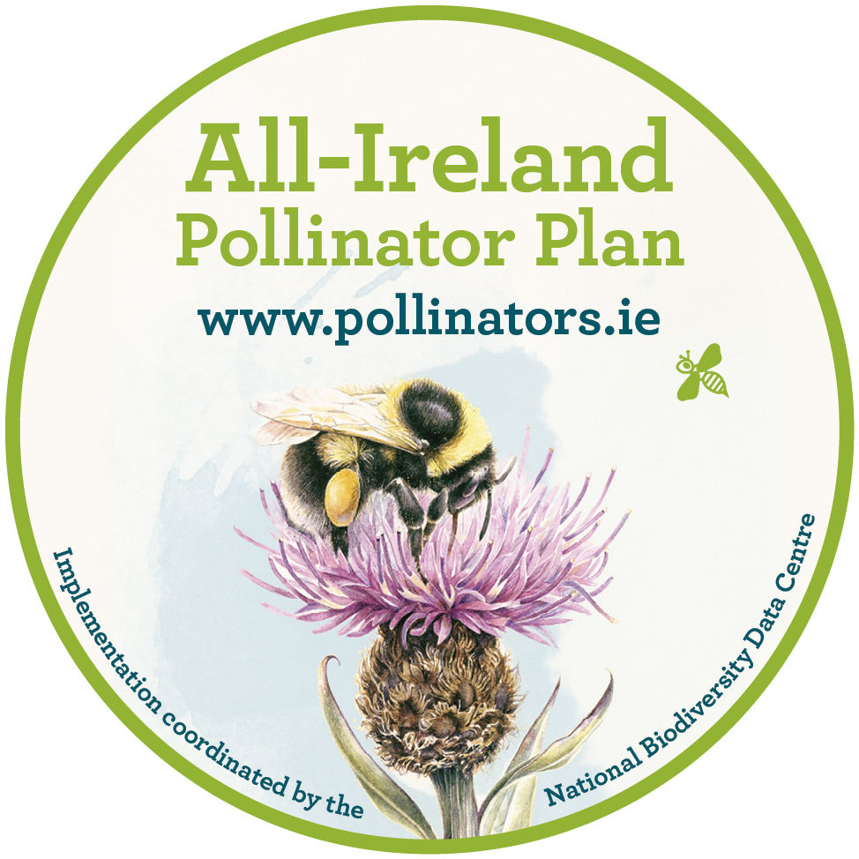
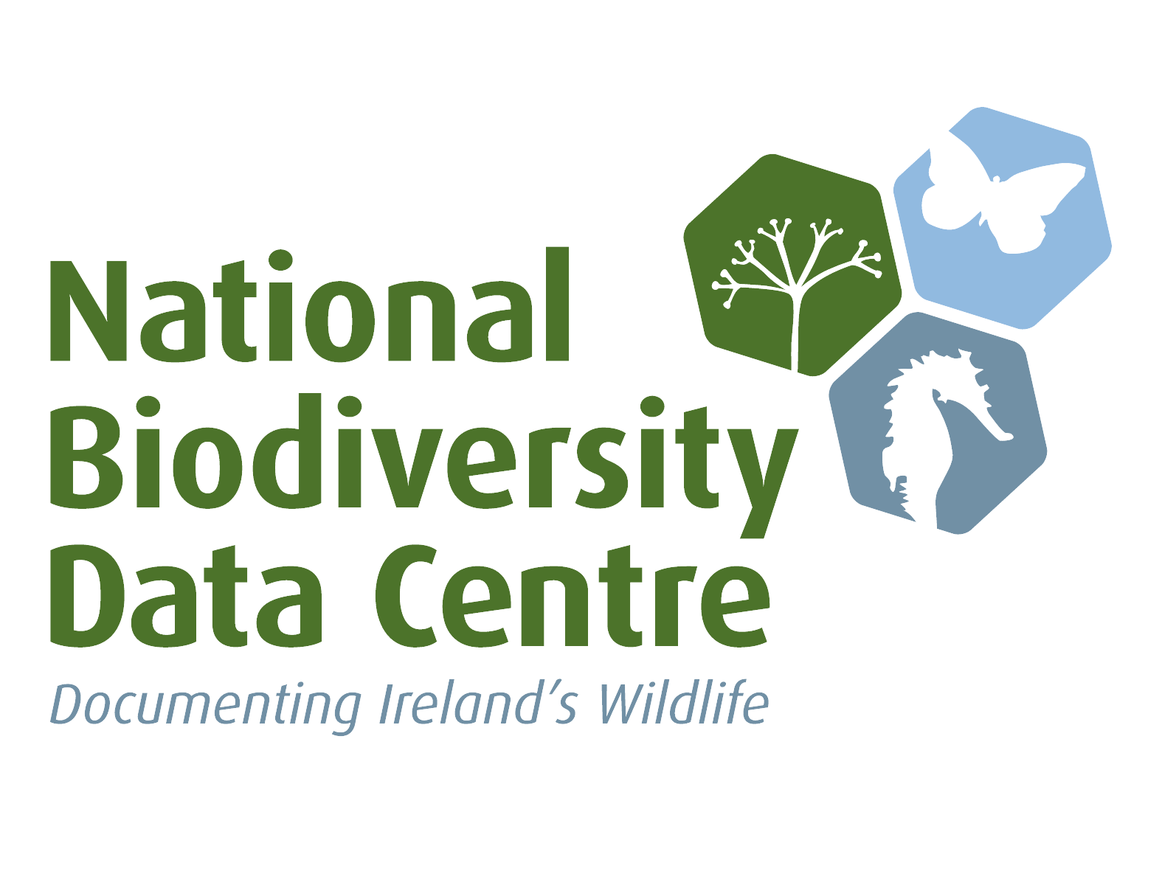
How Communities can Help Pollinators
Kate Chandler
Communities Pollinator Officer
www.pollinators.ie
Notes:
The All-Ireland Pollinator Plan is a framework bringing together different groups across the island of Ireland to create a landscape where pollinators can survive and thrive. It is coordinated by the National Biodiversity Data Centre.

Slide 2
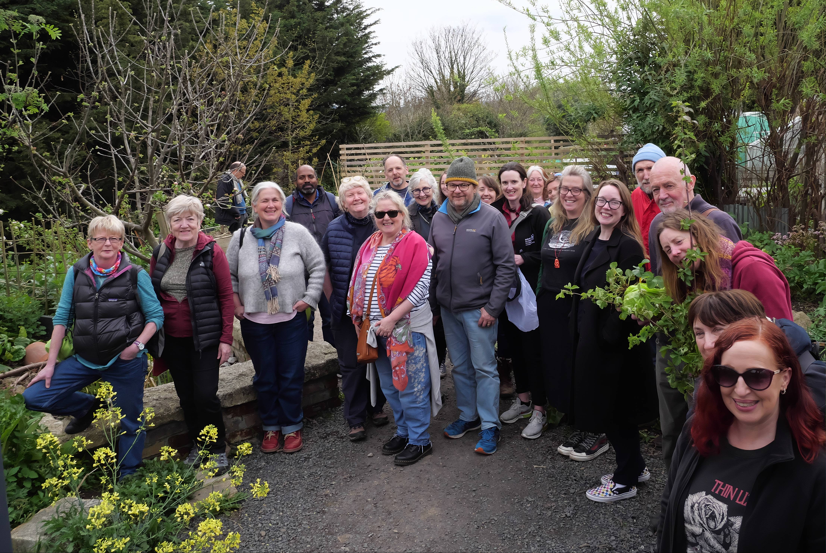
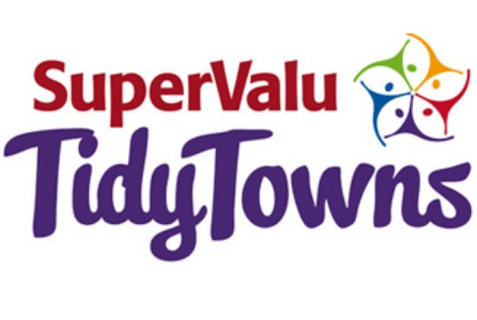
AIPP 2026-2030: Buzzing Communities
Vision: Thriving populations of wild pollinators are sustained in local communities. Across the island of Ireland, a wide range of community groups are working together to protect, enhance, and create habitats with food and/or shelter for pollinators at 200-metre intervals in cities, towns, villages, and rural areas.
As well as transforming the landscape for pollinators through evidence-based actions, these efforts are helping to improve human health and wellbeing in our communities. Communities are recognised and celebrated for their role in transforming the landscape for pollinators.
Notes:
In new AIPP, I look after Buzzing Communities work package.
The vision is:
Celebrated through Pollinator Awards
Also have other plans for recognising local champions, and towns that have gone pesticide free.
So much great work is already being done by communities. We’ll hear from some groups today. And we know it’s working.

Slide 3
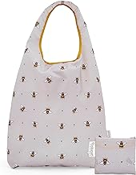
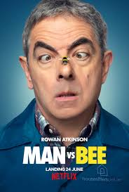
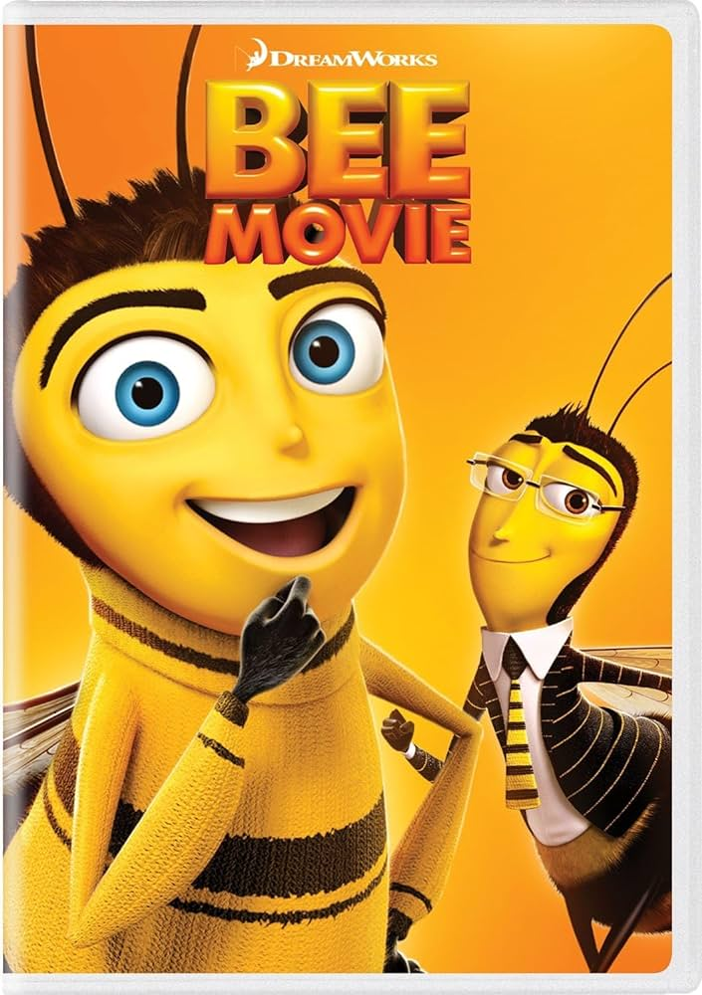
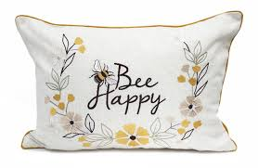
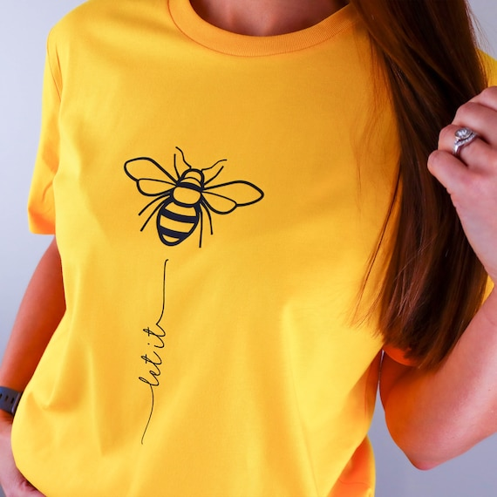
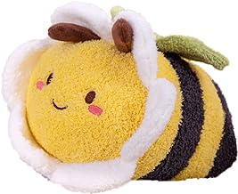
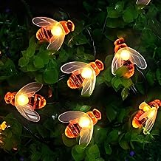
Notes:
First I want you to all think about how bees seem to be everywhere.
Have you noticed there are bees everywhere? I don’t mean real bees going about their business around us, I mean on accessories, soft furnishings, clothing.
If the abundance of bees in our material and popular culture was any indication of their actual abundance, our job would be done, there’d be no need for the Pollinator Plan - they’d be thriving.
What does this mean? Why are bees so prevalent in material and popular culture? Is it just a fad of consumerism – feeding our desire for stuff and entertainment, or does it reflect a deeper attachment, something that we can somehow access, channel, and turn into action?
Something to think about over the course of the weekend.

Slide 4
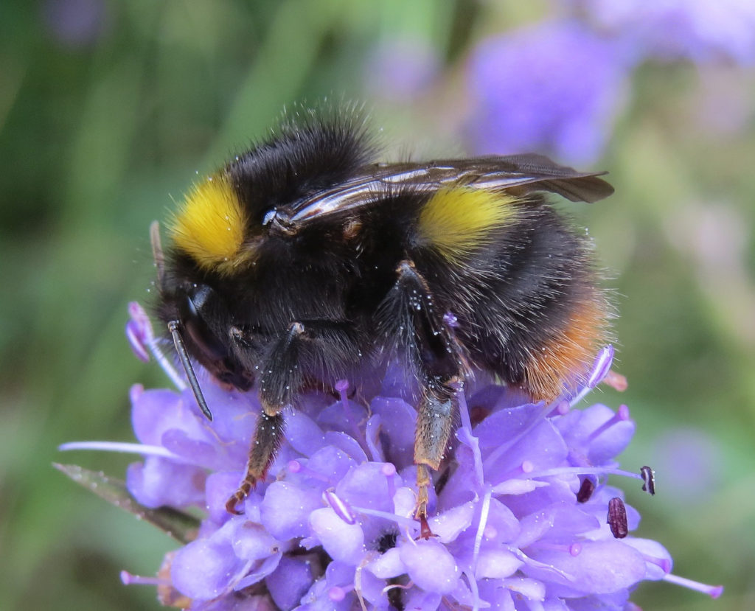

What’s the problem?
One third of bee species in Ireland is threatened with extinction
  Habitat loss
  Decline in wildflowers
  Pests and disease
  Pesticides
  Climate change
78% of our wild plants are pollinated by insects
100 crops provide 90% of the world’s food. 71 of these are pollinated by bees.
Notes:
One third of bee species in Ireland is threatened with extinction
This is because we have drastically reduced the habitats that provide them with food and safe nesting sites – also because of pests and disease, use of pesticides and climate change.
Bumblebees tend to forage within 1km of their nest. Solitary bees only forage within a few hundred metres. Most wild bees don’t make honey, so they have no way of storing food. They are never more than a few days away from starvation so it’s crucial that there is a reliable supply of food for them in the landscape.
78% of our wild plants are pollinated by insects – that includes trees and flowers
100 crops provide 90% of the world’s food. 71 of these are pollinated by bees.

Slide 5
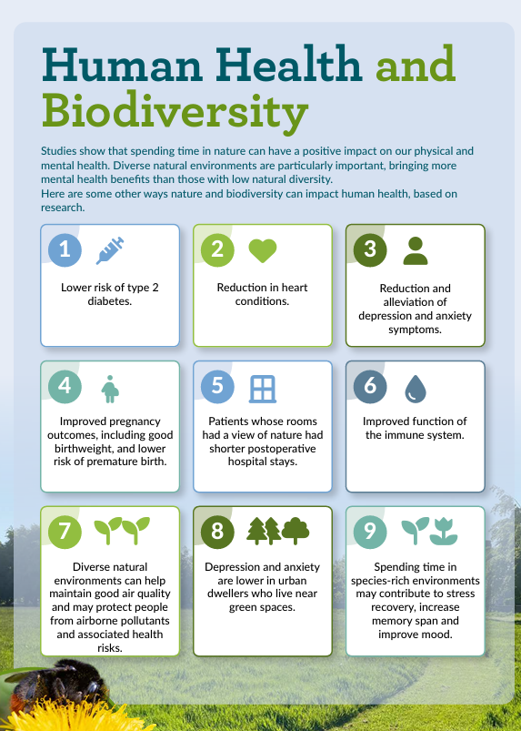
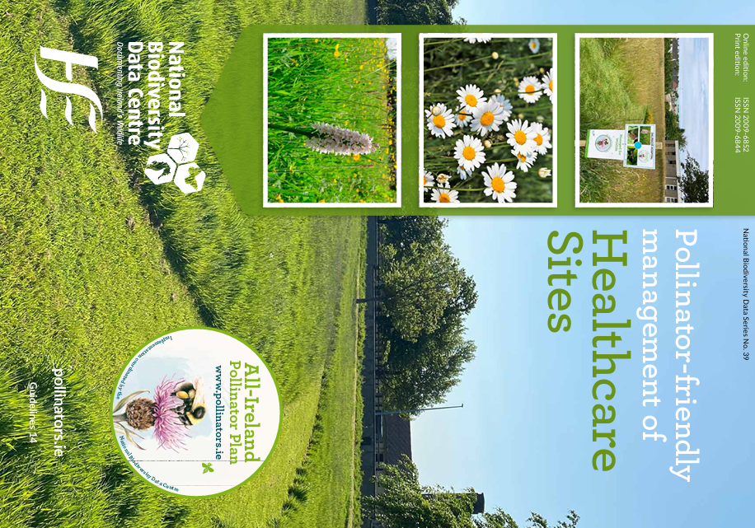
Notes:
So you can see how we need pollinators to ensure the sustainability of our food production – we need them for our own survival; to protect the health of the environment; and of course these creatures deserve a landscape that supports them for their own sake.
The good news is there are very simple actions we can take to help them.

Slide 6
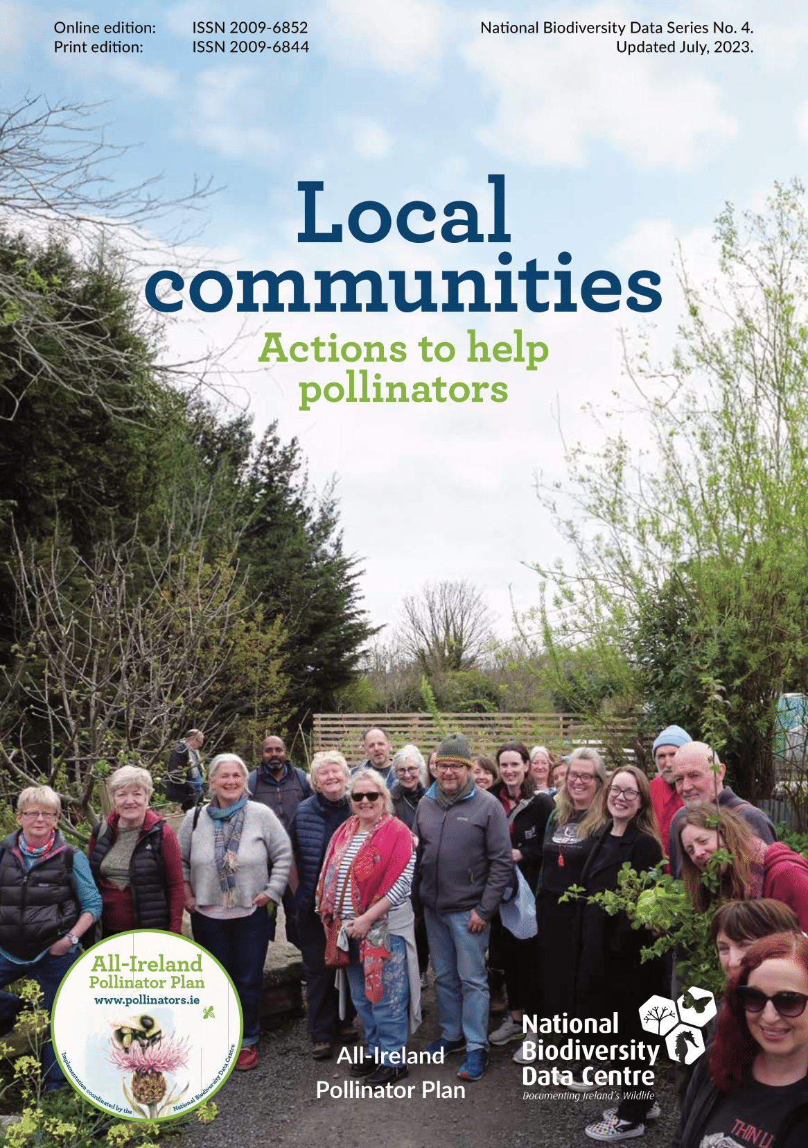
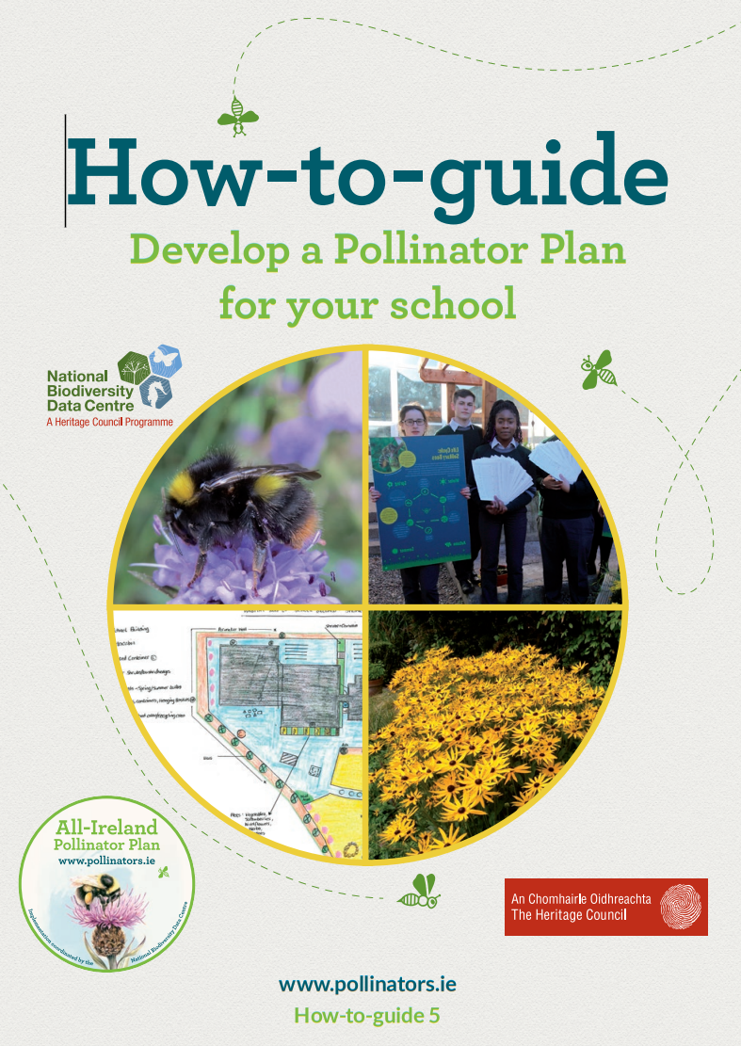
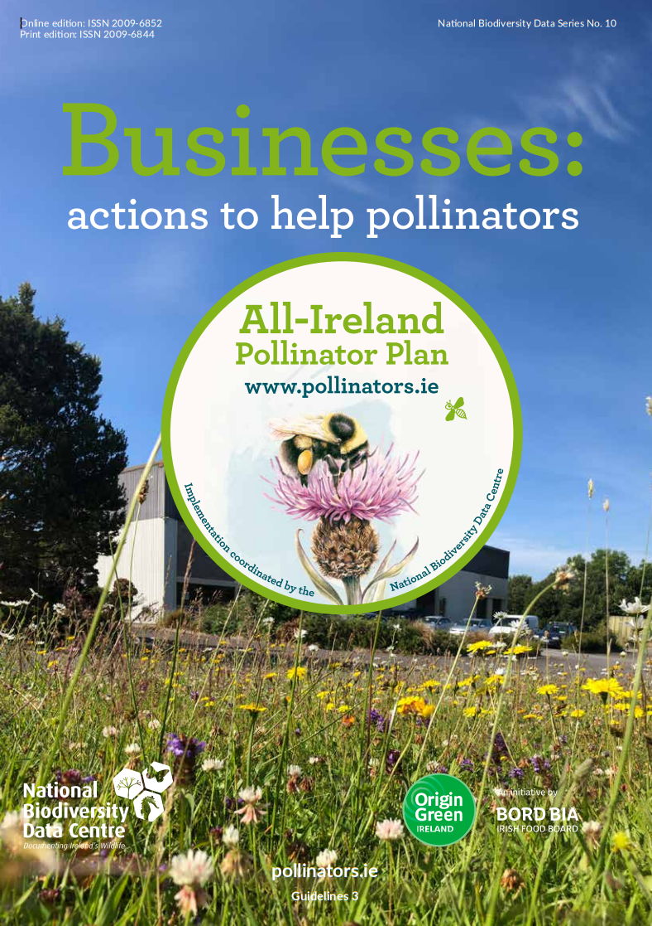
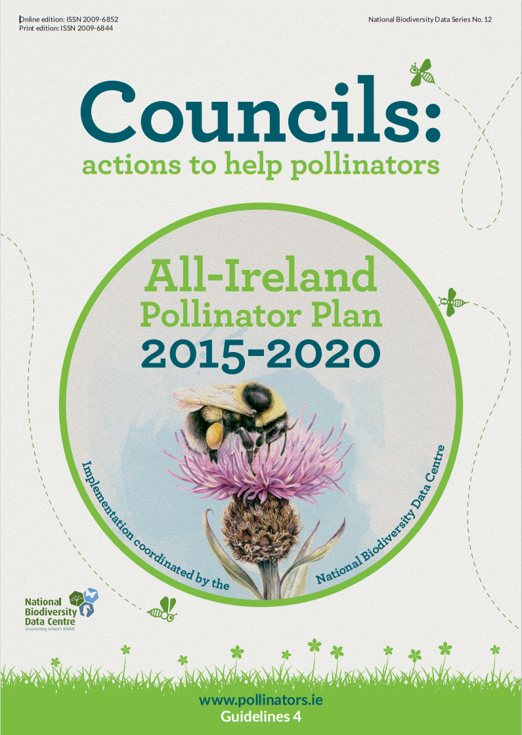
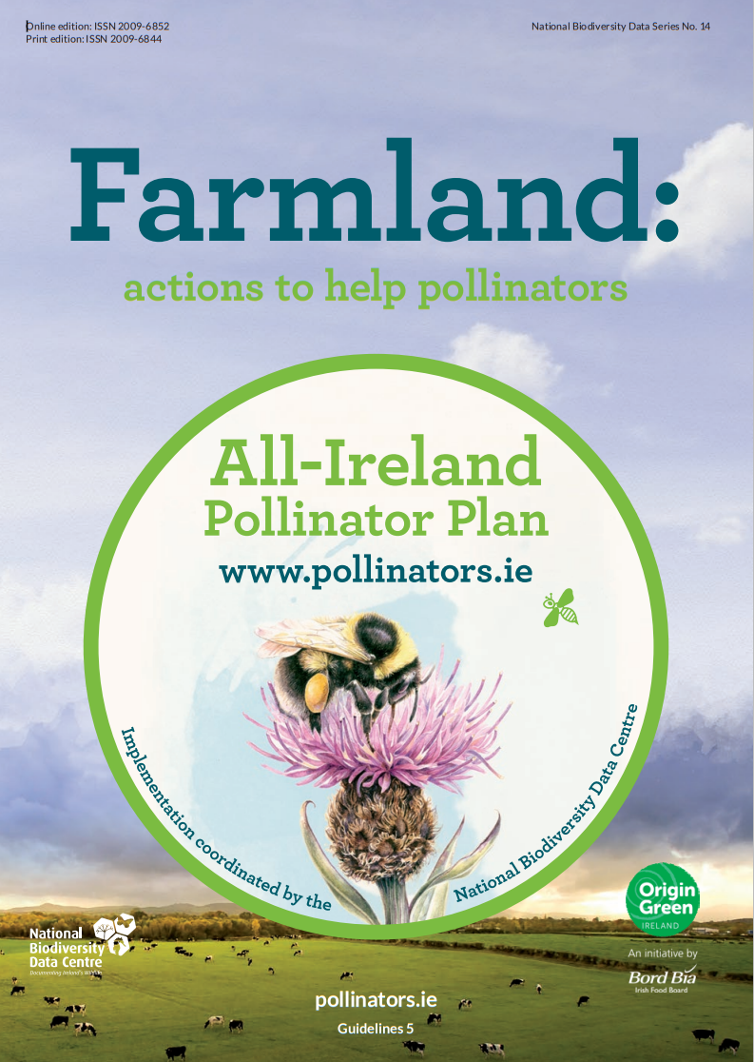
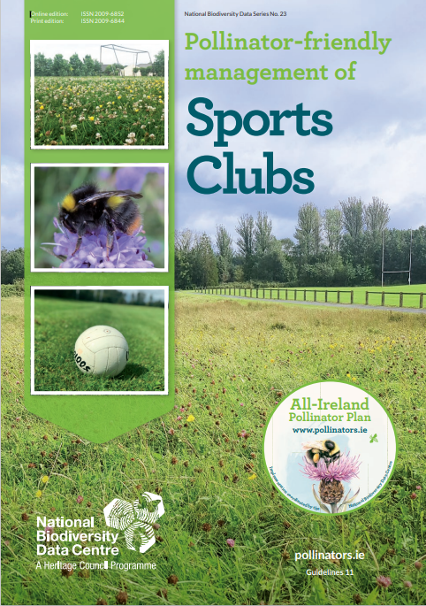
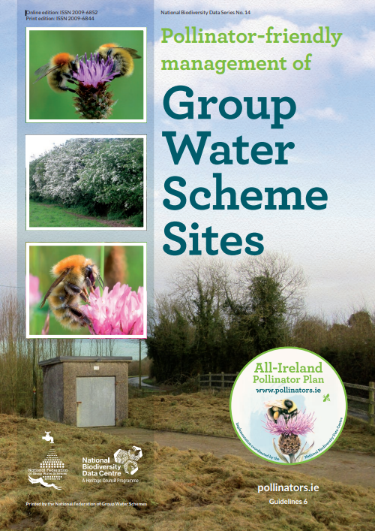
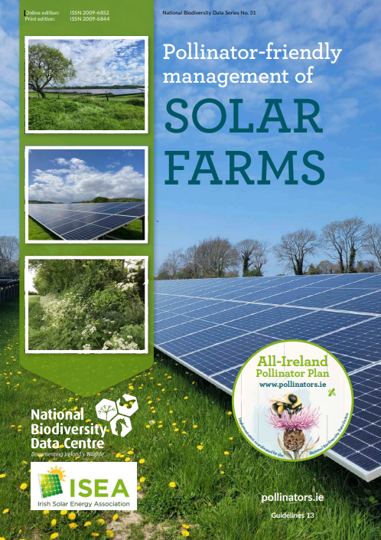
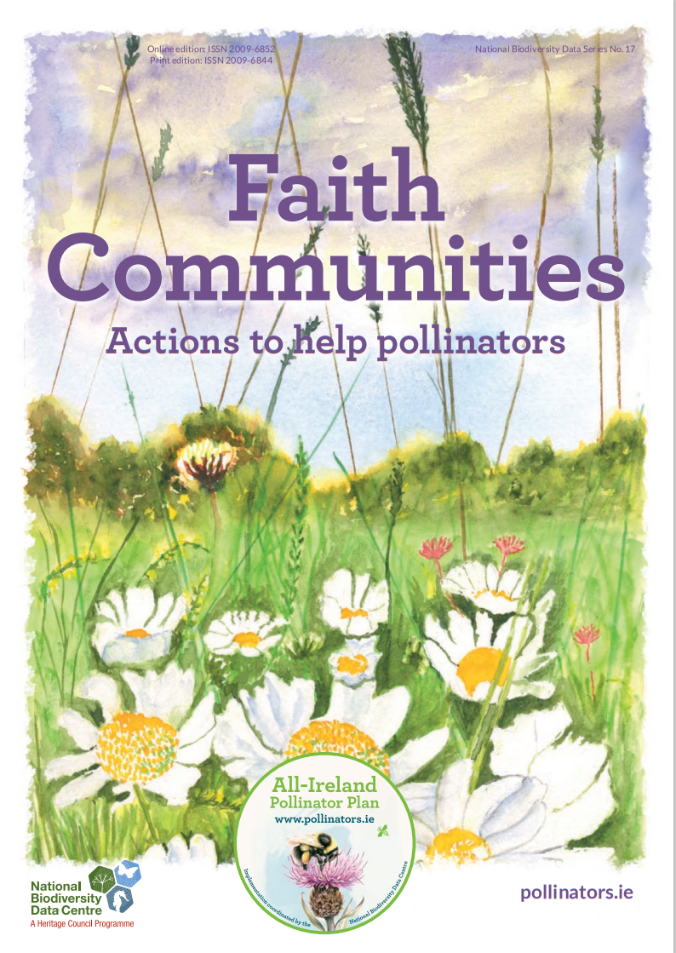
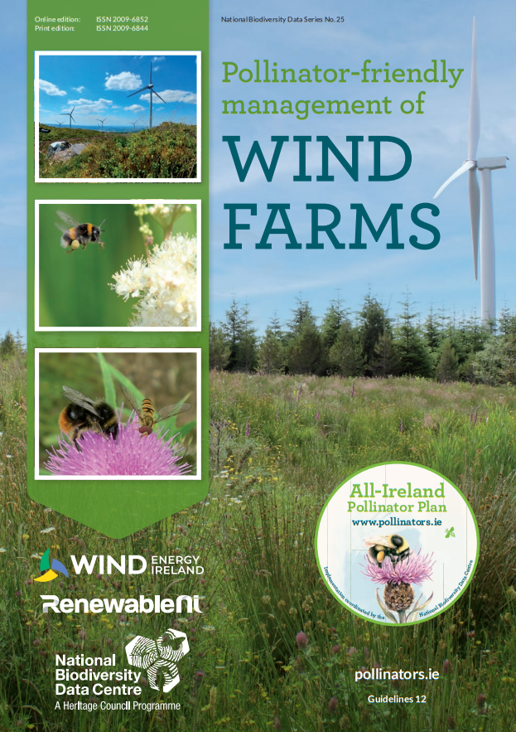
Notes:
We have a number of resources that cover all of these actions in detail.
Guidelines for local communities, available in Irish too. This is a good place to start if you want to start taking action in your community. Also have guidelines for schools, businesses, councils, farmers, sports clubs, faith communities, group water scheme sites, and wind and solar farms.
The actions are broadly the same but they’re tailored to these different contexts, e.g. planting pollinator-friendly flowers in your sports club colours, working with suppliers, or creating a pollinator-friendly prayer garden in a faith community.
You can download these for free from our website pollinators.ie under resources.

Slide 7
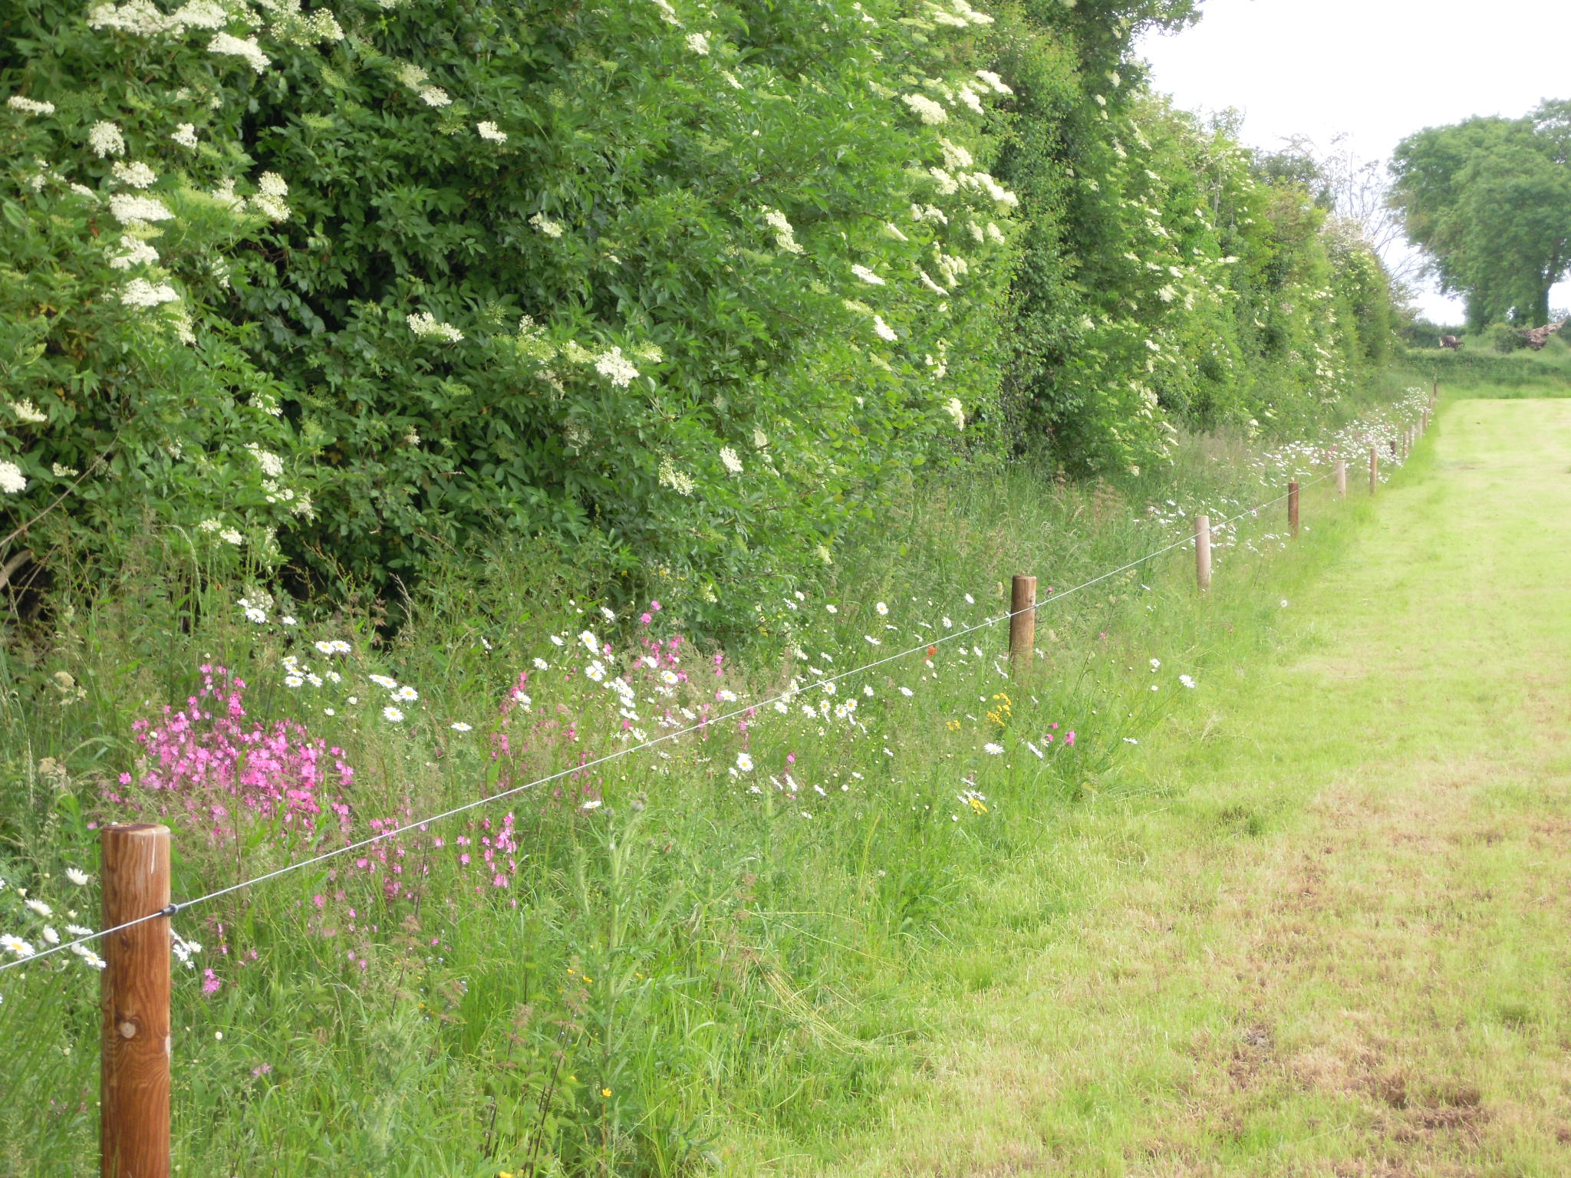
Before doing anything…
Protect what’s already there
Identify habitats in your community – what species are present?
Do a survey, engage an ecologist if you can
Identify any invasive species that need to be removed.
Plan to protect what’s there
Map the habitats in your community.
Pic: Donal Sheehan
Notes:
Before you do anything – protect what’s already there.
Everywhere is different. You might be surprised by what habitats already exist in certain places.
So before you start making changes, take the time to get to know your space – are there native wildflowers or flowering hedgerows? Are there drystone walls or areas of bare earth, or wild areas? Make it your priority to protect them, and then enhance them.
Think about how you can join the dots between habitats to create ecological corridors.

Slide 8
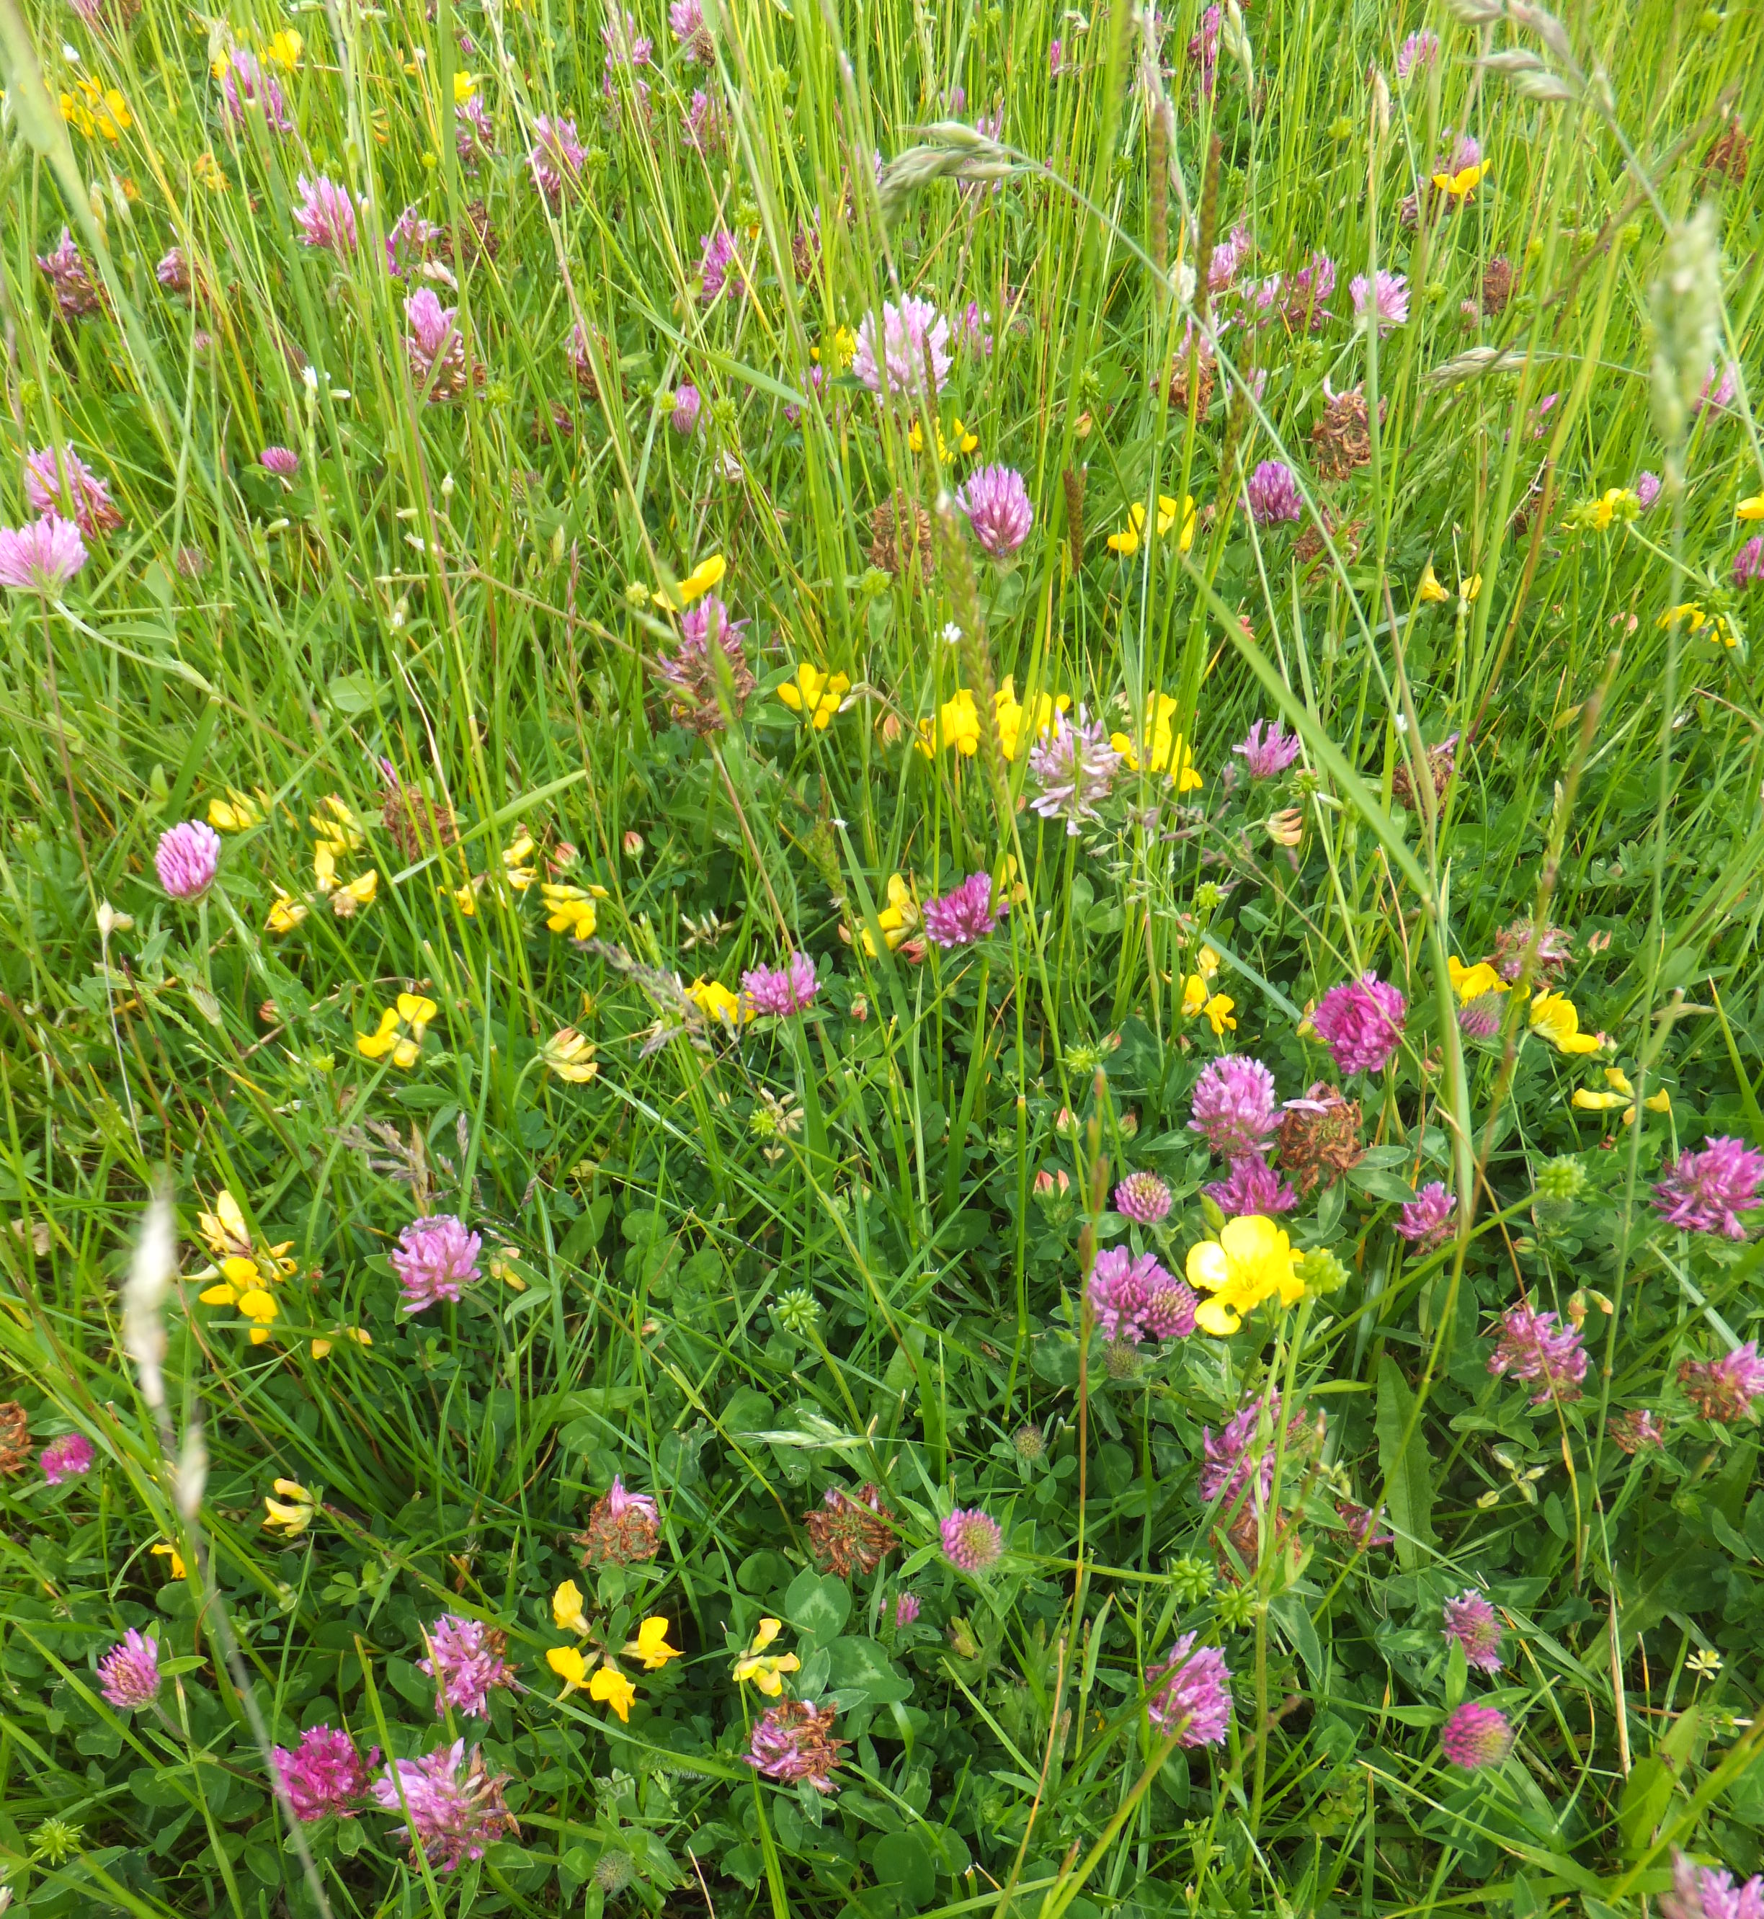
1. Don’t mow let it grow
Pollinators need species-rich grasslands.
Reducing mowing allows native wildflowers to return naturally over time.
Short-flowering meadow:
  Cut every 6 weeks starting mid-April
Long-flowering meadow:
  Cut once a year in September providing food and shelter.
Pic: Dara Stanley
Notes:
Reducing mowing is the absolute best thing you can do for pollinators.
As we’ve seen, pollinators are in trouble due to the loss of food and habitat – what we call species-rich grassland which include a wide variety of native wildflowers they have evolved alongside. Reducing mowing allows native wildflowers like Dandelions, Clover and Birds-foot Trefoil to naturally return over time.
There are a few options for reducing mowing depending on your space
Short-flowering meadow: You could create a short-flowering meadow. Cut every 6 weeks starting in mid-April to allow the first Dandelions to come up. This allows clover to appear on a rotational basis.
Long-flowering meadow: that’s cut once a year in September allowing the seeds to drop in August.
This takes a couple of years to fully establish – because the soil at first will be too fertile to support a lot of wildflowers, so make sure you remove grass cuttings when you mow to help reduce the fertility of the soil.
Meadows can be a bit challenging, particularly in areas where green spaces are used for a variety of activities
Choose your areas carefully – think about what will work for you community - if an area is used for sports or similar, not ideal, but there might be areas around the edge you can use. If an area is prone to littering or dog fouling, that might not be ideal either – you’ll need to make sure you litter pick the area before mowing a long-flowering meadow.
And long-flowering meadows, off-season, can look messy. Some groups have had success mowing paths through these areas so the management is obviously deliberate, or using signage to explain

Slide 9
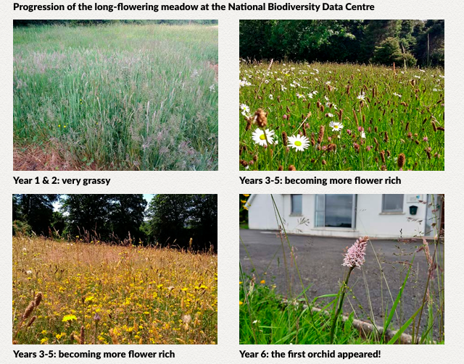
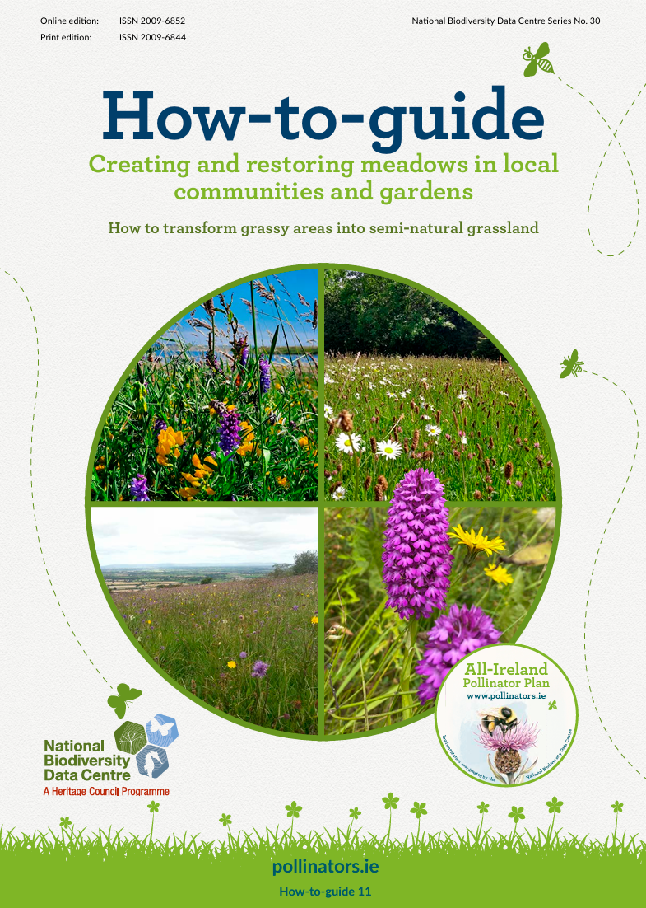
1. Don’t mow let it grow
Some things to bear in mind:
Choose the right place
Get permission
Plan when & how to cut
Plan how to dispose of cuttings
Be prepared to remove some plants
Accept it will take time
Accept it will sometimes look messy!
Notes:
Choose the right place: Sunny, open location, as far as it is possible to know, the soil fertility is not extremely high – e.g. on thinner soils.
You accept that the meadow will look untidy at times, especially in late summer
Plans are in place for cutting the long grass in September and lifting those cuttings
Plans are in place for removing and disposing of the cuttings e.g., composting

Slide 10
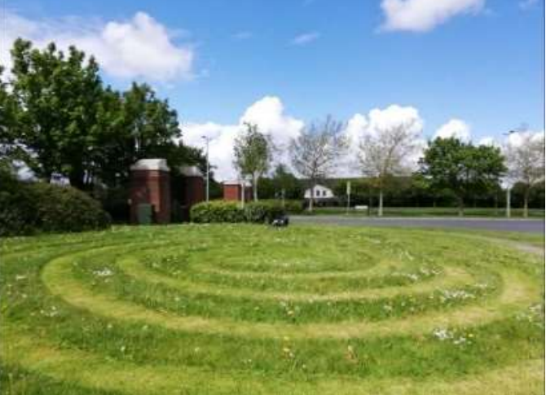
1. Don’t mow let it grow
Pollinators need species-rich grasslands.
Reducing mowing allows native wildflowers to return naturally over time.
Short-flowering meadow:
  Cut every 6 weeks starting mid-April
Long-flowering meadow:
  Cut once a year in September providing food and shelter.
Pic: Woodstown Residents Association

Slide 11
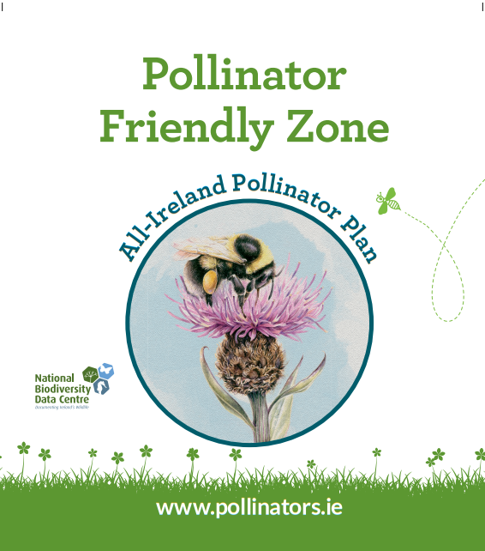
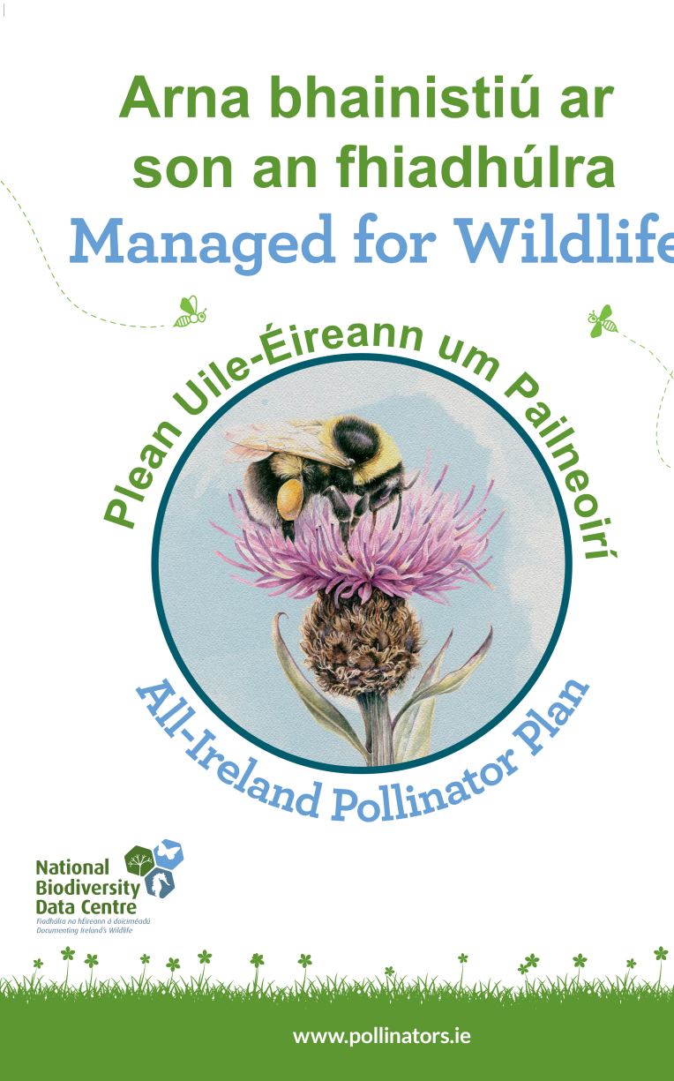
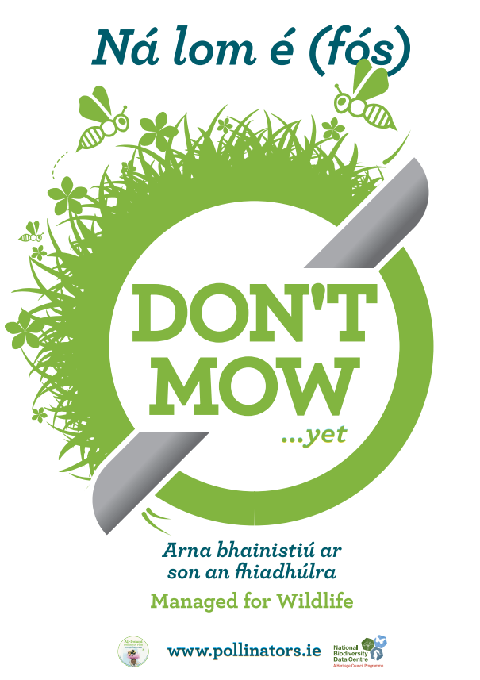
Notes:
There is freely downloadable signage on the resources page of our website, pollinators.ie . These are just some of the signs you can download.

Slide 12
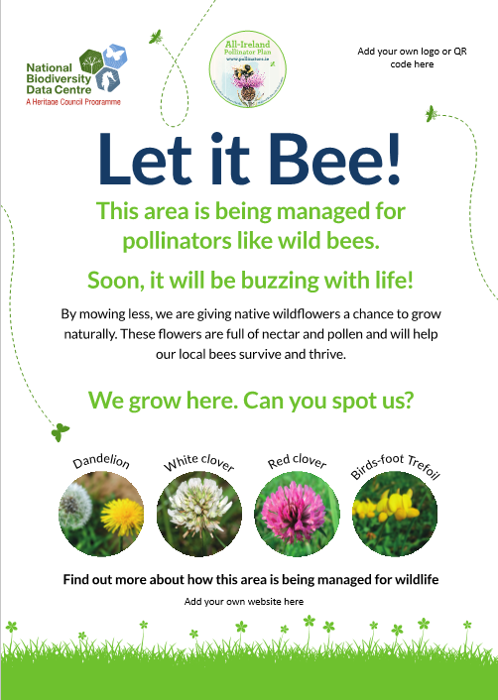
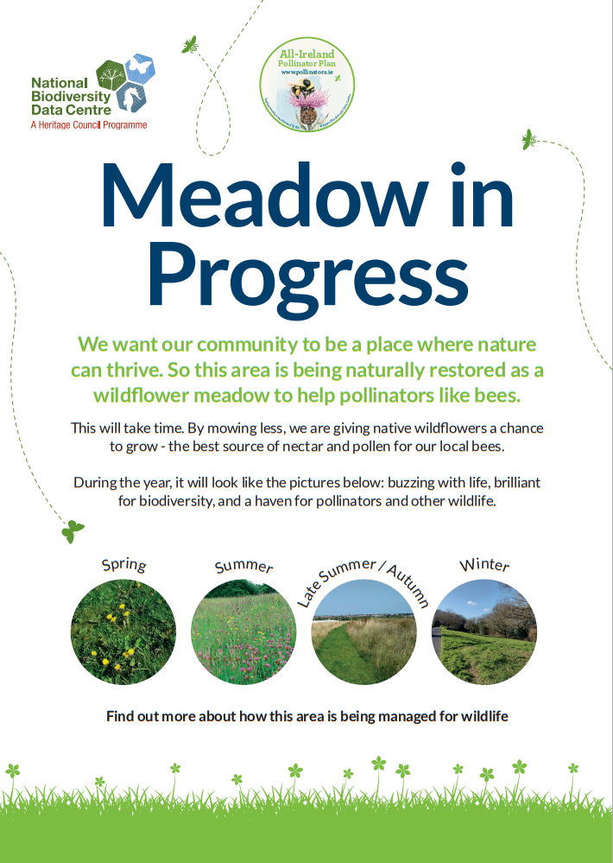

Slide 13
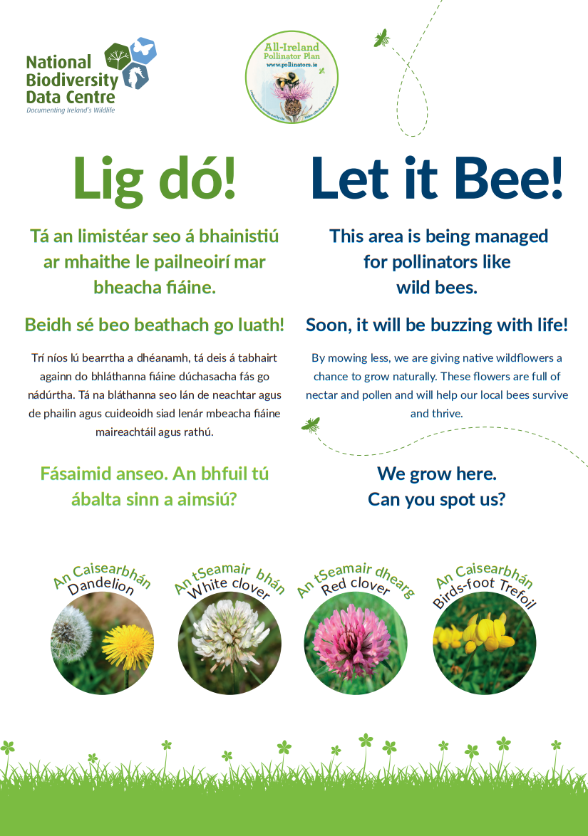
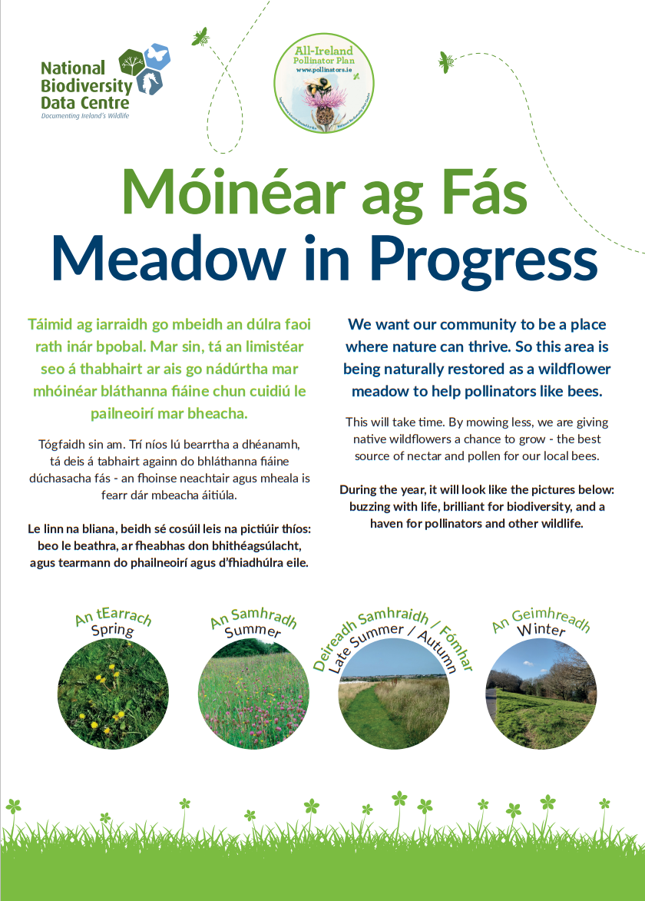

Slide 14
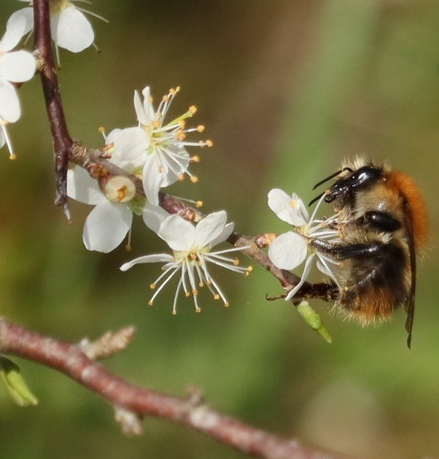
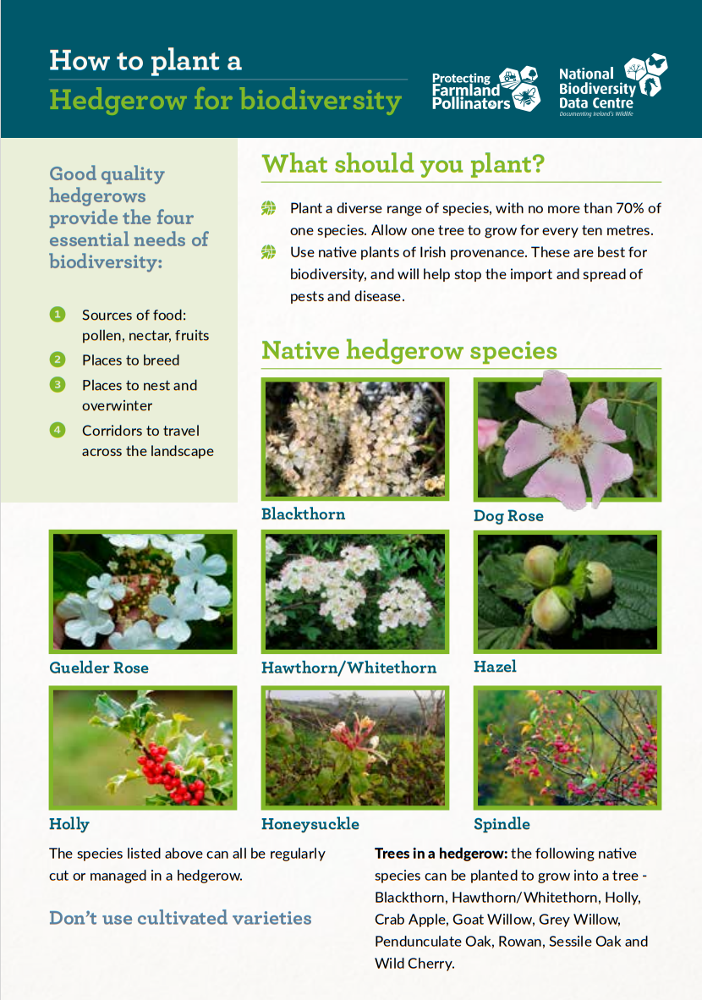
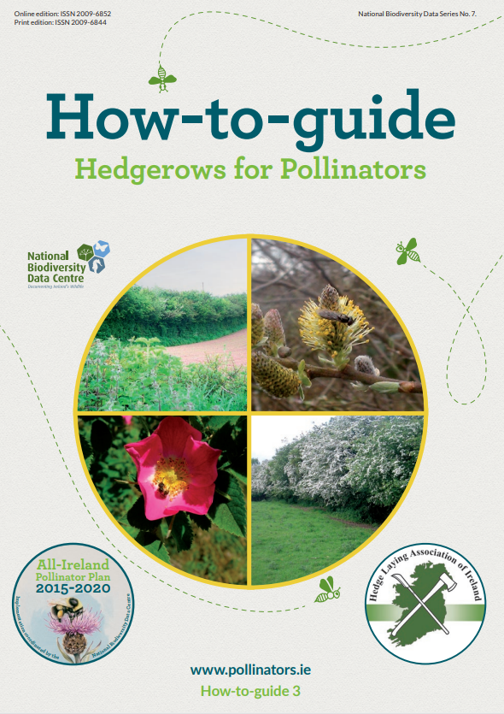
2. Protect and create native hedgerow
Native hedgerow such as Hawthorn and Blackthorn flower in spring, providing important food for pollinators emerging from hibernation.
Flowers grow on older wood, so avoid cutting annually
Cut on a three-year rotation in a natural A shape
Common Carder Bee on Blackthorn Pic: Lill Dunne
Notes:
Native hedgerow includes Hawthorn (also called Whitethorn) and Blackthorn. These flower in spring, providing food for pollinators emerging from hibernation. Queen bumblebees emerge in early spring and start to look for somewhere to nest – they need access to thousands of flowers so this early food is vital. Hedgerows also form important ecological corridors.
If you’re managing a hedgerow, allow them to grow into a natural A-shape profile. Flowers grow on older wood, so avoid cutting annually – cut on a three-year rotation instead to allow them to flower in spring.
Further info: We have a guide for this on our website

Slide 15
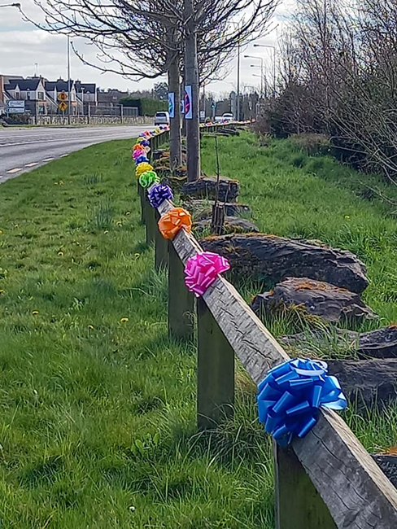
Examples
Woodstown, Dublin
  Planted new hedgerow along M50 linking with existing hedgerows to create a wildlife corridor from the Dublin hills down to the motorway
Julianstown Community Gardens
  Replaced fence with native hedgerow during council works
Notes:
In Woodstown, Woodstown Village Residents Association created a new hedgerow along the M50, connecting existing hedgerows and creating a wildlife corridor from the Dublin hills to the M50. This is a great example of how hedgerows can help join the dots and connect the other habitats in your area.
Julianstown Community Gardens in Meath: planted a double row of native Irish hedging. The Council were putting in a new drainage system and they used this opportunity to replace the wooden fence that was there before.

Slide 16
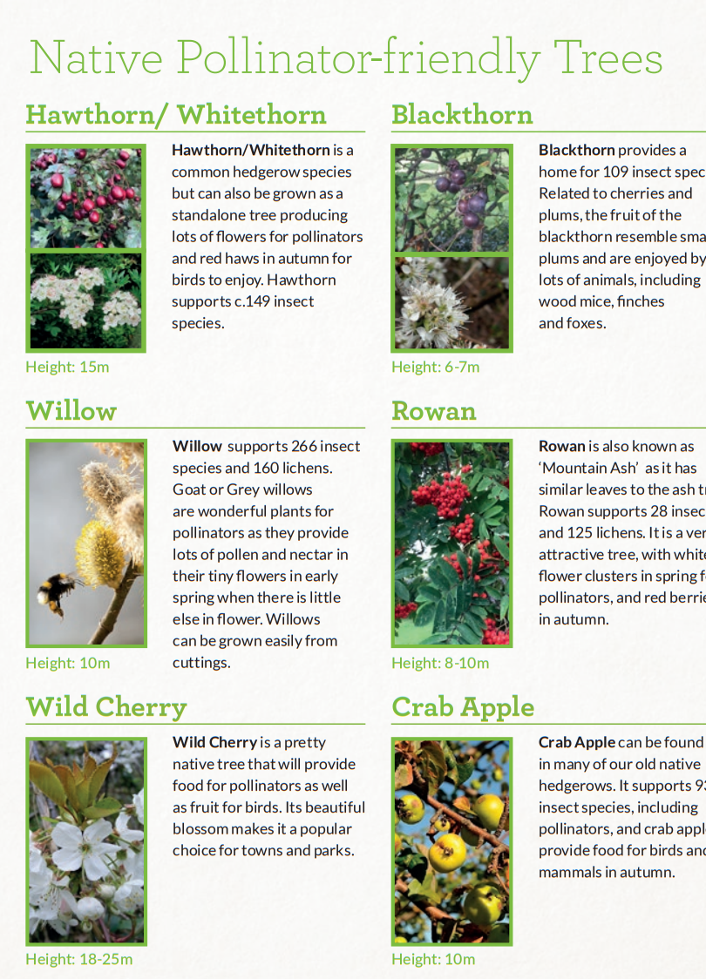
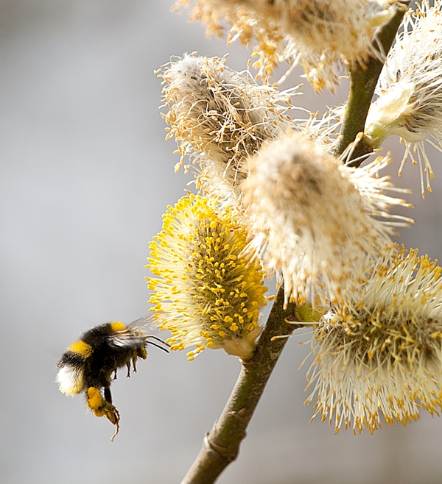
3. Plant pollinator-friendly trees
Native trees and shrubs such as Willow, Rowan, Crab Apple and Holly support huge numbers of pollinators.
Right tree (native, local provenance)
Right space (what will happen to tree in the future?)
Right place (avoid habitats already valuable for biodiversity)
Bumblebee and a willow flower
Notes:
Native trees and shrubs such as Willow, Rowan, Crab Apple, and Holly support huge numbers of insects including pollinators, they also flower quite early so are important in the same way hedgerows are.
More broadly they contribute to a healthy climate and biodiversity, supporting a rich variety of organisms like lichens, birds, mammals.
Plant a young tree in the autumn or winter, or grow them from seed. You can get small varieties that are good for smaller gardens.
Remember: right tree, right space, right place.

Slide 17
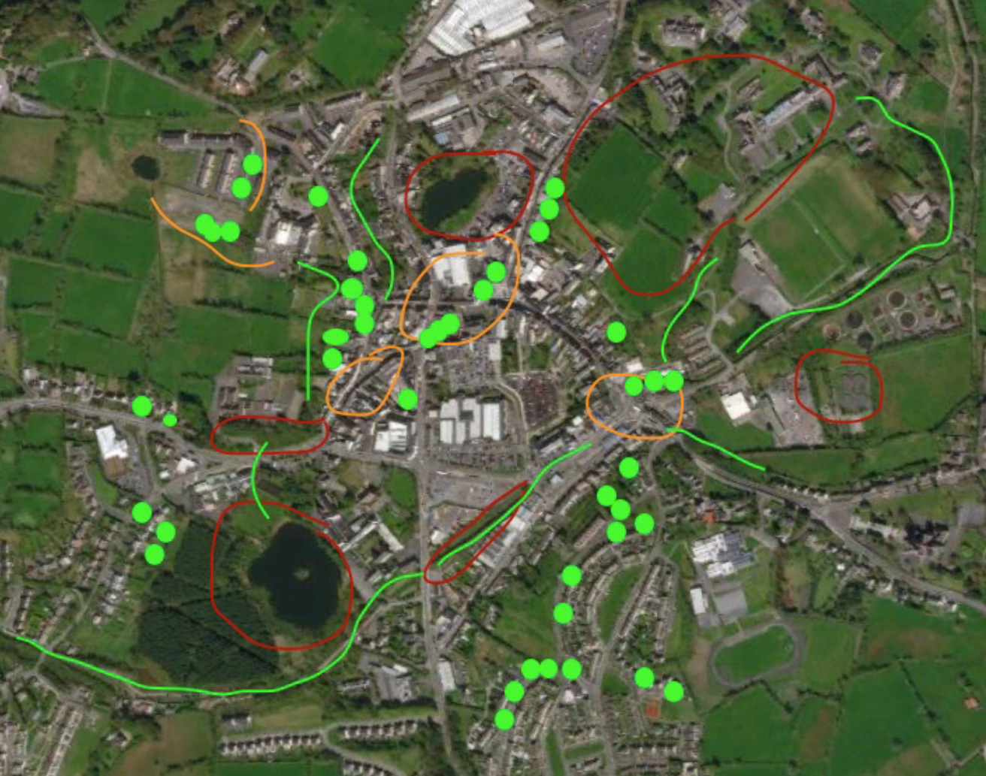
Examples
Monaghan
  Dispersed urban orchard mapping project
Rathgar Parish Biodiversity Garden
  Planted trees with help of Pocket Forests
Dispersed urban orchards in Monaghan
Notes:
- Monaghan Tidy Towns ran the Dispersed Urban Orchard project – sourced local heritage apple trees, advertised: “Fruit Trees for a Fiver: Come and pick up your fruit tree for a fiver in Monaghan shopping centre. All you have to do is be a Monaghan Town resident and (crucially) tell us exactly where you live and commit to planting it there. Then created a map of where these apple trees were being planted
You don’t need to plant hundreds of trees – just a few can make a huge difference – organisations like Pocket Forests and Stepping Stone forests that are working to plant trees in small spaces.

Slide 18
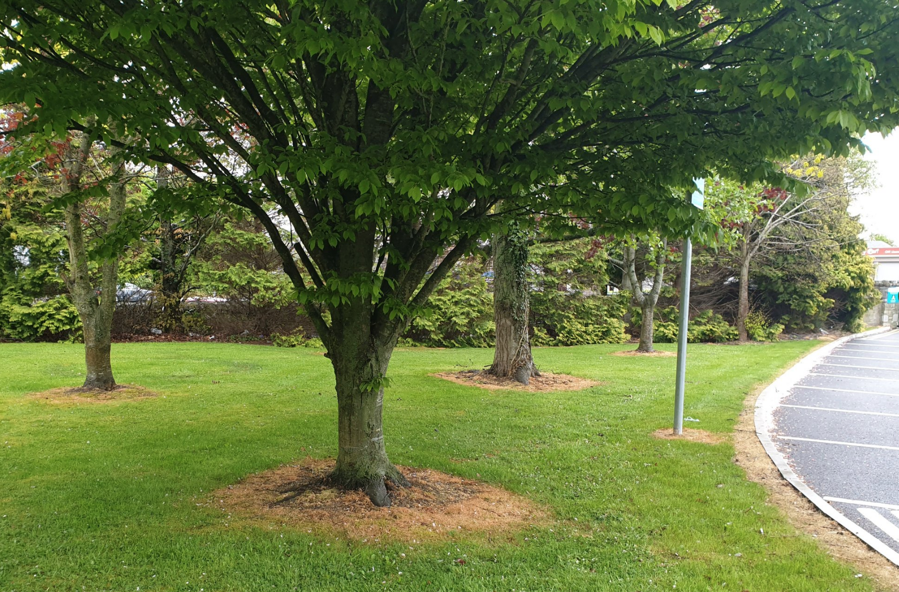
4. Avoid pesticides
Herbicides, insecticides, and fungicides
These chemicals have been found to kill, harm, and disorientate pollinators, either directly through exposure or indirectly by killing or poisoning their food.
‘Weeds’ such as dandelions are often an important food source for pollinators.
Pesticide use around the base of trees. Pic: Billy Linehan
Notes:
This next one is a big one.
Pesticides include herbicides, insecticides and fungicides. They are potent chemical cocktails designed to kill various organisms. I’m probably preaching to the converted here, but one of the best things you can do for pollinators is avoid using them. They have been found to kill, harm, and disorientate pollinators either directly through exposure or indirectly by killing or poisoning their food.
If you buy plants at a garden centre, ask if they have been treated with chemicals. Even ‘bee friendly’ labelled plants may have been treated with pesticides.
Part of this is about changing how we view ‘weeds’ – these plants are often vital food sources for pollinators.
If you have to remove these plants, avoid chemicals and do it by hand, or if that isn’t possible use alternatives. We’re currently gathering feedback from councils, and our partners and supporters on the different types of pesticide alternatives they’ve used, and will be providing more info on that over the coming months.
Herbicides should still be used to remove invasive species such as Japanese Knotweed.

Slide 19
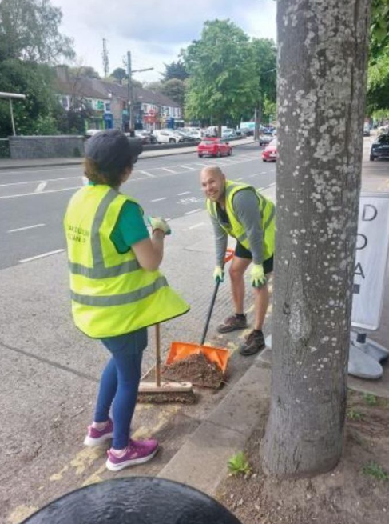
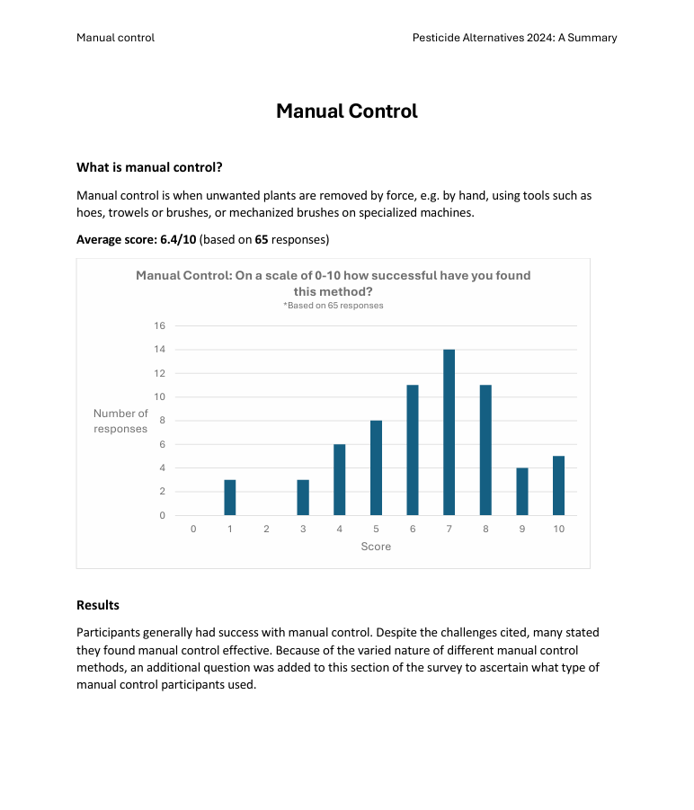
4. Avoid pesticides
Herbicides, insecticides, and fungicides
These chemicals have been found to kill, harm, and disorientate pollinators, either directly through exposure or indirectly by killing or poisoning their food.
‘Weeds’ such as dandelions are often an important food source for pollinators.
Pesticide use around the base of trees. Pic: Billy Linehan
Notes:
This next one is a big one.
Pesticides include herbicides, insecticides and fungicides. They are potent chemical cocktails designed to kill various organisms. I’m probably preaching to the converted here, but one of the best things you can do for pollinators is avoid using them. They have been found to kill, harm, and disorientate pollinators either directly through exposure or indirectly by killing or poisoning their food.
If you buy plants at a garden centre, ask if they have been treated with chemicals. Even ‘bee friendly’ labelled plants may have been treated with pesticides.
Part of this is about changing how we view ‘weeds’ – these plants are often vital food sources for pollinators.
If you have to remove these plants, avoid chemicals and do it by hand, or if that isn’t possible use alternatives. We’re currently gathering feedback from councils, and our partners and supporters on the different types of pesticide alternatives they’ve used, and will be providing more info on that over the coming months.
Herbicides should still be used to remove invasive species such as Japanese Knotweed.

Slide 20
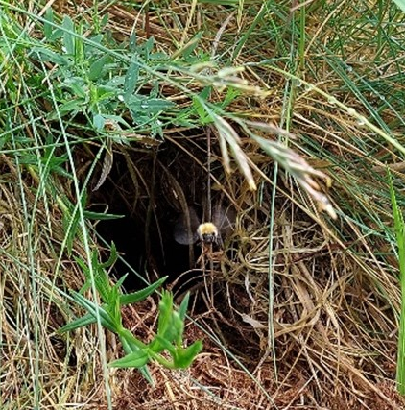
5. Create nesting habitat
Wild pollinators nest in hedgerows, long grass, dry stone walls, and in bare earth.
Scrape back some bare earth on sunny slopes
Drill holes 10cm deep in unvarnished wood for solitary nesting bees
Choose areas near flowers
  Bumblebees travel 1km
  Solitary bees only travel a few hundred metres
Common Carder Bee flying out of a tussocky grass nest
Notes:
Most bees don’t live in beehives. Wild pollinators nest in hedgerows, wild areas, dry stone walls, and even in the ground. To make a nesting habitat for them, just scrape back some bare earth, leave some areas to grow wild, or simply drill holes in unvarnished wood for solitary bees.
We’ve already seen it’s important that bees have a food source near their nest, so choose areas that have flowers nearby.

Slide 21
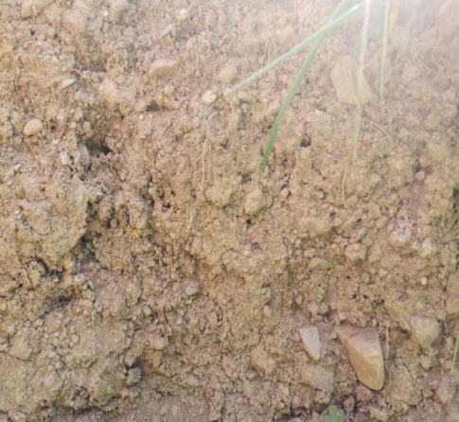
Examples
Woodstown
  Protecting dumped earth spoils and scrambler tracks as habitats for mining bees
Notes:
There’s a great example from Woodstown of how some of the best habitats are not what you might expect – scrambler tracks, and dumped earth spoils, while not ideal - are great potential nesting habitats for mining bees, and these bare earth spaces have already seen wildflowers return.

Slide 22
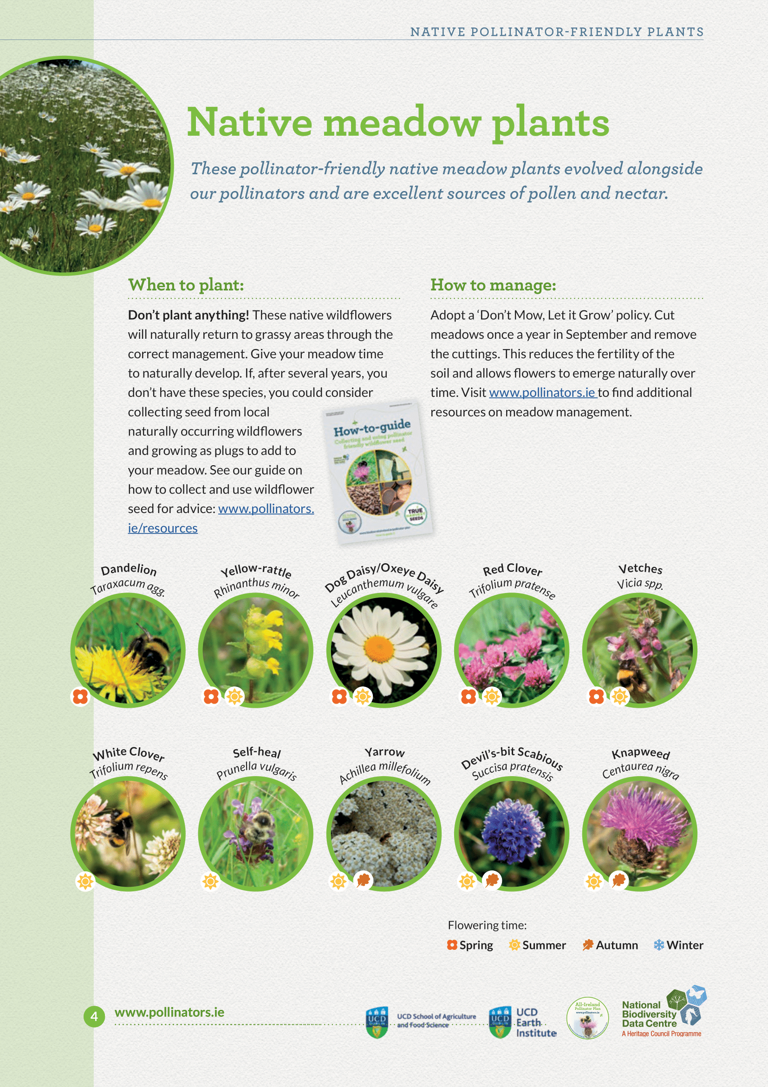
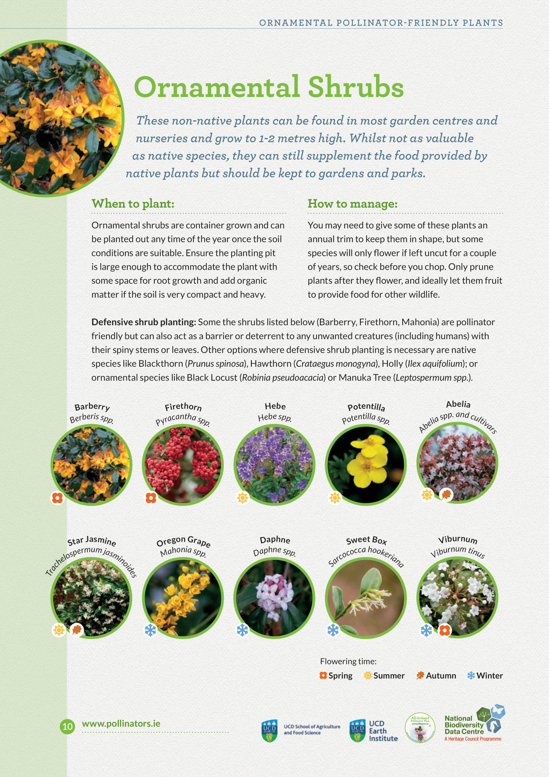
6. Pollinator-friendly planting
Choose nectar and pollen-rich plants. Try to choose plants that will provide food throughout the year.
Perennials are generally better than annuals
Bidens and Bacopa look great in containers and hanging baskets
Herbs such as Rosemary, Thyme, and Chives
Bulbs like Snowdrops, Crocuses, and Grape Hyacinth provide vital early food
Notes:
Pollinator friendly planting is another big one. First thing to say is generally, native plants are better for pollinators than non-native ‘ornamental’ plants – have evolved alongside one another
But many ornamental plants provide lots of pollen and nectar too, and there is a place for them in garden and parks settings.
Top 10 Pollinator-friendly plants for different situations looks at both.
Not all plants are pollinator-friendly. You might be surprised to hear that popular plants like daffodils, tulips, and begonias aren’t great sources of nectar and pollen.
When you’re planning what to plant, try to choose plants that will flower throughout the year (between February and October)
Perennials are generally better than annuals, and are often cheaper
Loads of advice in the guide

Slide 23


6. Pollinator-friendly planting
Choose nectar and pollen-rich plants. Try to choose plants that will provide food throughout the year.
Perennials are generally better than annuals
Bidens and Bacopa look great in containers and hanging baskets
Herbs such as Rosemary, Thyme, and Chives
Bulbs like Snowdrops, Crocuses, and Grape Hyacinth provide vital early food
Notes:
Bidens and Bacopa are great bedding plants for small containers and hanging baskets
Heathers are good for roundabouts – low maintenance, early source of food

Slide 24


6. Pollinator-friendly planting
Choose nectar and pollen-rich plants. Try to choose plants that will provide food throughout the year.
Perennials are generally better than annuals
Bidens and Bacopa look great in containers and hanging baskets
Herbs such as Rosemary, Thyme, and Chives
Bulbs like Snowdrops, Crocuses, and Grape Hyacinth provide vital early food
Notes:
Herbs like Thyme and Rosemary are also great choices
Plant bulbs such as Snowdrop, Crocus, and Grape Hyacinth in the autumn to provide early food for emerging pollinators the following spring

Slide 25


Examples
Clonmel’s ‘Bucket of Bulbs’ initiative with local schools
Kilsheelan’s beautiful pollinator-friendly beds
Raheny’s tallest Sunflower competition
Edible herb planters for community use
Community gardens
Pollinator-friendly planting in Kilsheelan, Tipperary
Notes:
Clonmel ran a ‘Bucket of Bulbs’ initiative with local schools – distributing pollinator-friendly bulbs to schoolchildren and through the community.
You can get really creative with this action, e.g. edible herb planters, community gardens.

Slide 26


Notes:
Making a pollinator-friendly rainwater planter is a great way to help pollinators and mitigate impacts of climate change.

Slide 27

Notes:
- If you want a bigger project, you, could create a pollinator-friendly sensory garden
These are places that provide opportunities to connect with nature through the senses.
They’re becoming more and more popular as we learn about the importance of connecting with nature for our health and wellbeing.
And again, this flyer is available to download from our website.
The next three are things you need to be a bit wary of

Slide 28

7. Be careful with honeybee hives
On the island of Ireland, we have one native honeybee and it is not in decline.
Too many managed hives can lead to competition with wild bees.
When taking actions for sustainability, be clear about the benefits and possible impacts.
Bumblebee and Honeybee (Pic: Michael Ryan)
Notes:
Think twice about getting a hive of honeybees
The first thing to say is that all pollinators are important and have a role to play, but on the island of Ireland, we have one native honeybee species, and it is not in decline.
Most honeybees are living in hives and managed by beekeepers.
If we have too many honeybee hives in the landscape, they can compete for food with our wild pollinators which are already struggling.
You should only get a honeybee hive if you want to start a new hobby, but it’s not an action for biodiversity
If you are thinking of getting a hive of honeybees, please get in touch with your local beekeeping association to learn how to keep healthy honeybees; avoid spreading disease to other hives and to our struggling wild pollinators. There are many fantastic beekeeping associations around the island of Ireland who are doing great work, particularly to protect our native Irish black bee.

Slide 29


8. Be careful with wildflower seed mixes
Wildflower seed mixes have been found to contain non-native species and can inadvertently introduce invasive species.
If you must use them, make sure they are native species and of Irish origin.
Or, collect seeds from local wildflowers in August when meadows drop their seeds.
Notes:
Be careful with wildflower seed mixes.
Earlier I spoke about creating more areas for wildflowers by reducing mowing and you might have wondered why I didn’t suggest sowing wildflower seeds.
You might be surprised to hear that sowing wildflower seed mixes can damage local biodiversity.
Many wildflower seed mixes have been found to contain non-native species, and can inadvertently introduce invasive species – so they will not result in that all-important species-rich grassland that we spoke about earlier.
So approach these with caution. If you do decide to sow wildflower seed mixes, keep to garden settings, ensure they are native and of Irish origin.
Alternatively, there is a way you can collect and sow seeds from local wildflowers when they drop their seeds in late summer Several groups have run successful projects harvesting local wildflower seed and distributing it locally

Slide 30


9. Don’t install a large bee hotel
Large bee hotels can encourage the spread of disease and attract predators.
Avoid anything larger than an average-sized bird box.
A bee hotel should be no bigger than an average bird box
Notes:
Number 9, don’t install large bee hotels. Bee hotels provide nesting habitat for cavity nesting bees - but if they’re too big they can encourage the spread of disease and attract predators.
Avoid anything bigger than an average-sized bird box, and keep it away from bird feeders so the insects aren’t easy targets for predators.
There are many other ways to create nesting habitats for pollinators which I spoke about earlier and we have guidelines on that too.

Slide 31

10. Work with others & spread the word
Work with others within your community to make the greatest change.
  Tidy Towns
  Schools
  Faith communities
  Men’s Sheds
  GAA/ sports clubs
  Local businesses
Create biodiversity walking trails
Raise awareness through social media, local newsletters
Blarney Street Pollinator Path
Notes:
Last but not least, spread the word.
Change happens when word spreads. So many groups have already done amazing things by working with schools, businesses, faith communities, farmers, and local authorities. Find out who is doing this locally and work with them to create ecological corridors.
If you are a registered Tidy Towns group, you can apply to the Pollinator Award
Also have GAA Green Clubs programme, Green Schools, and last year the Irish Catholic Bishops Returning to Nature initiative – 30% of church grounds returning to nature by 2030.
In 2023, a residents’ association in Cork launched the Blarney Street Pollinator Path in Cork, encouraging residents to do just three things: pick a place, mow less, spray less – very accessible, a ‘way to start conversations’

Slide 32


Tracking Progress
Record your actions on Actions for Pollinators to help us track the progress of our pollinator-friendly landscape.
New Actions for Pollinators coming soon
Conduct surveys:
  Flower-Insect-Timed Counts (FIT Counts)
  Bumblebee Monitoring Scheme
Actions for Pollinators map (July 2024)
Notes:
We won’t know what we are doing is working unless we keep track of our actions.
Actions for Pollinators is a publicly available online map. Every dot is a site that has been added – different colours = different type of site, e.g. community groups, businesses, councils, farmers, gardens, sports club.
Useful for seeing if anyone else is managing their space for pollinators in your area.
Doing a survey of biodiversity in your area can help establish a baseline and track the impact of your actions. A couple of options:
Flower-Insect-Timed Counts (or FIT counts): 10 minute count of insects landing on plants. There’s a free app for that – find out more on our website.
Bumblebee Monitoring scheme - volunteers walk a fixed 1-2km route once a month between March and October and record the bumblebees that they see. The scheme is run by the National Biodiversity Data Centre who provide full support and training.
Both schemes help you track the impact of your work and help us keep track of insect numbers too
Some communities have found really rare pollinators this way

Slide 33
Find out more
Remember:
You don’t have to do everything at once
You don’t have to be an expert (help is out there!)
What we’re doing is working… we just need to do more!

Slide 34
Find out more
Lots of resources on our website
pollinators.ie
How-to guides and resources
Free downloadable signage templates
Free course in how to identify and record common Irish bumblebees
Notes:
There are loads more resources on our website, including how-to guides, plant lists and signage templates
Find us on Instagram or Twitter, join our newsletter mailing list.
Even doing just one of the actions I’ve spoken about today can make a difference.
Thank you for listening

